Slide 1
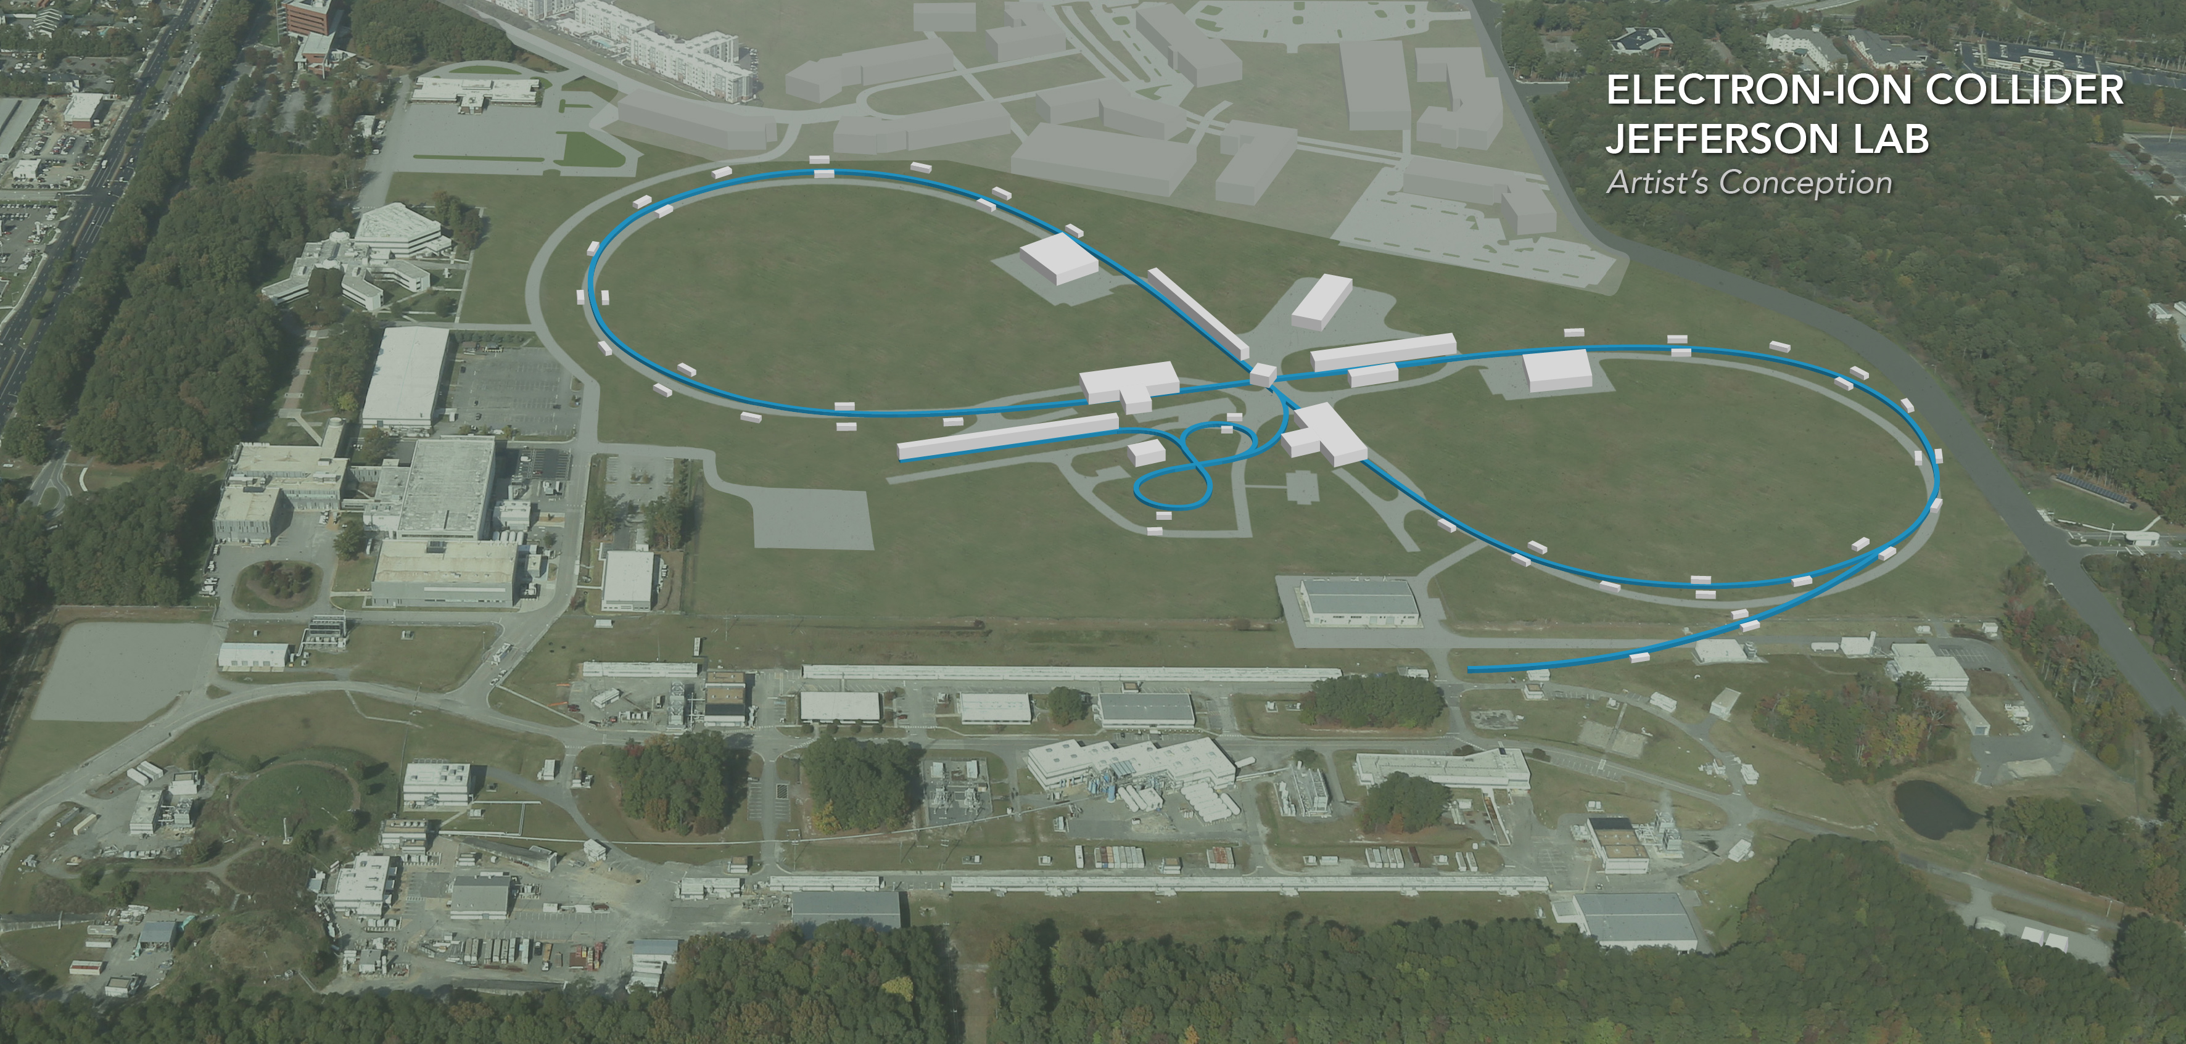
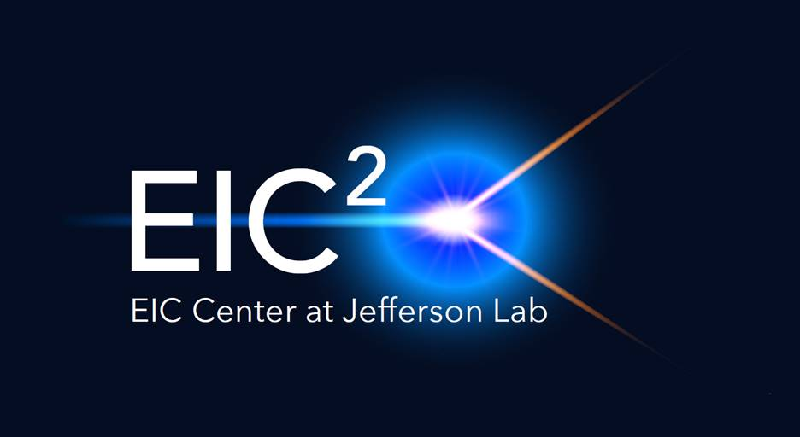
JLEIC Design Update (Oct. 2018)
JLEIC Collaboration

Slide 2
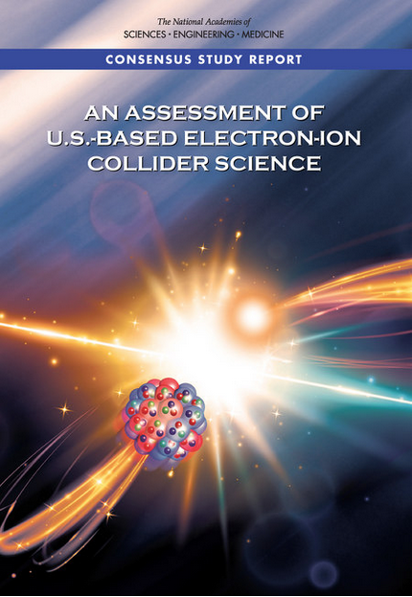
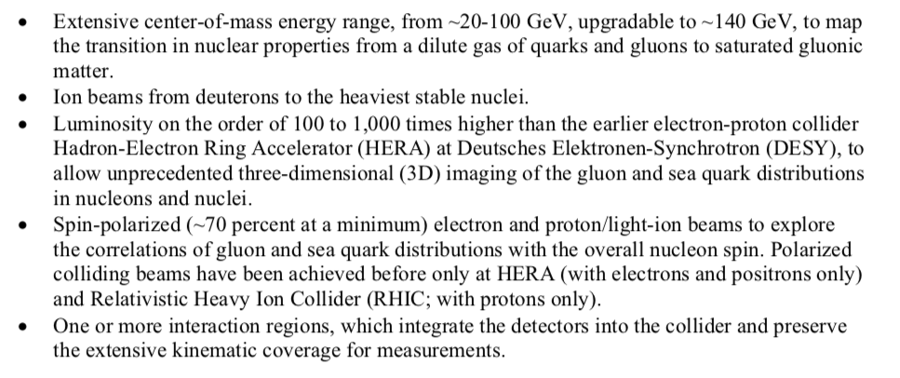
EIC Performance Requirements: NAS report
√s_{ep} range ~20 to ~100 GeV upgradable to ~140 GeV
Ion beams from D to heaviest stable nuclei
100 to 1000 times HERA luminosity—will discuss what this means
At least ~70% polarization for electrons, protons and light ions
One or more IR with integrated detector with high acceptance

Slide 3
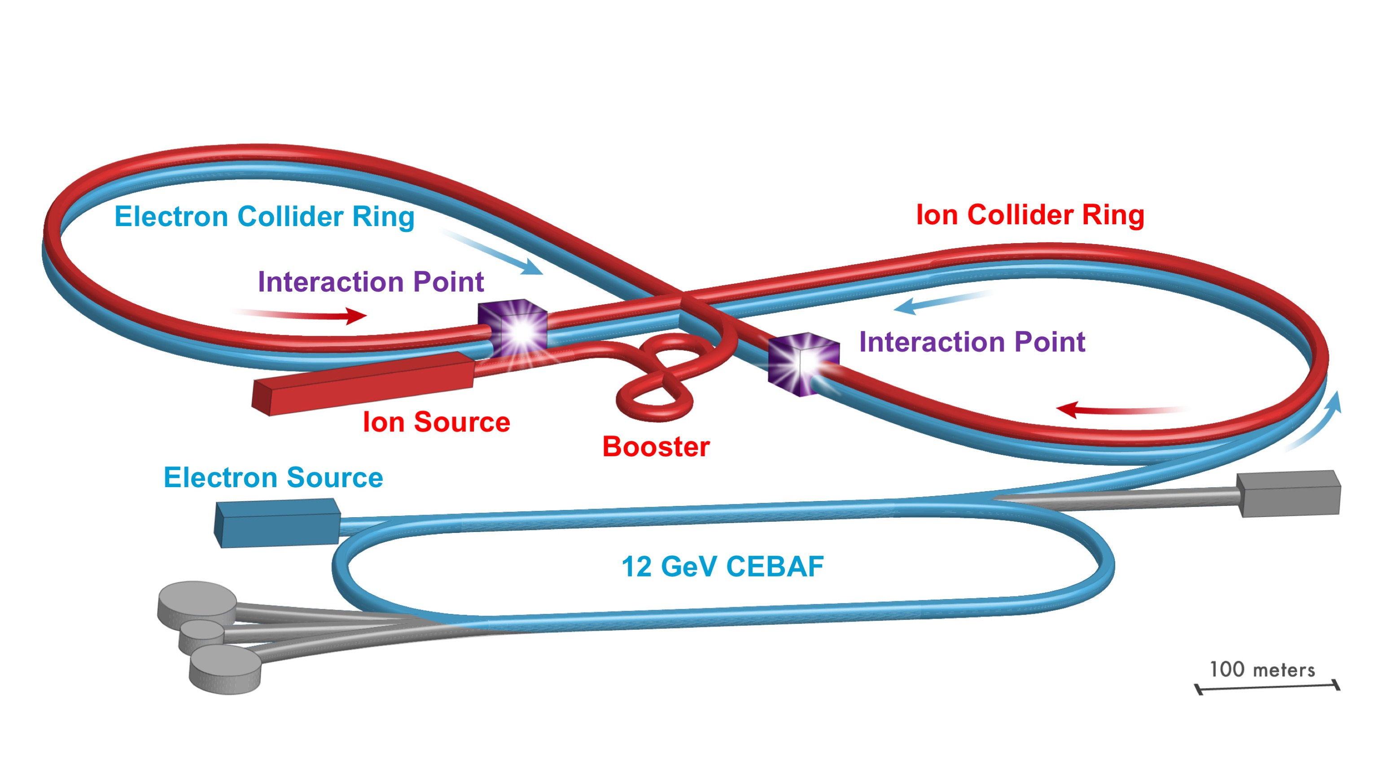
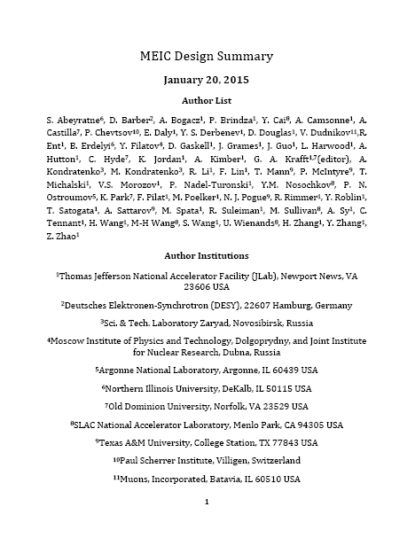
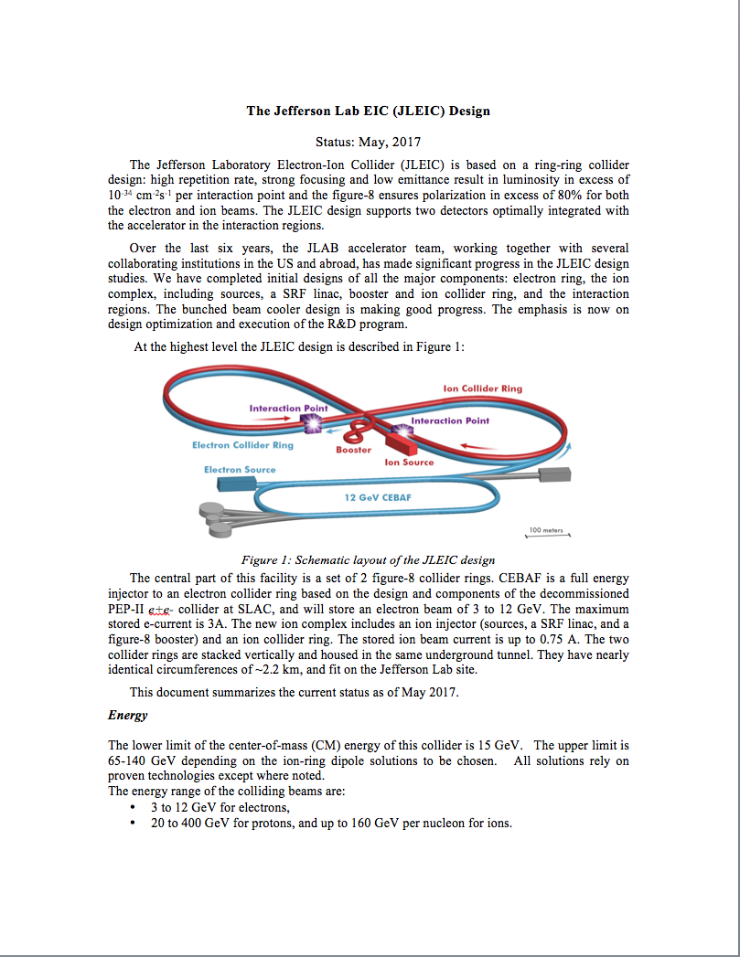
JLEIC Design Update (Oct. 2018)
Fundamental concept unchanged
This update:
Increase √s range by increasing ion ring dipoles from 3T→6T.
Keep the land footprint of the design the same.
The luminosity performance satisfies the requirements.
IR design retains high acceptance.
Polarization remains high.
Relatively small design changes
Update History
This Update
2015
2017
2018
arXiv:1504.07961
Document
Under development

Slide 4
JLEIC Design Update (Oct. 2018)
beam energy range:
E_{e}: 3 to 12 GeV (same as before)
E_{p}: 30 to 200 GeV (enabled by 3T→6T dipoles) upgradable to 400 GeV (use HE-LHC/FCC development—12T dipoles)
JLEIC Energy: √s = 20 to 100 GeV upgradable to 140 GeV
✔
Most of the design remains the same
Electron complex (unchanged)
CEBAF
Electron collider ring
Ion complex (mainly incremental changes)
Ion source
SRF linac
Booster
Ion collider ring (3T→6T dipoles)
Fully integrated high-acceptance IR (being re-optimized for higher energies) and detector
2 IRs with same acceptance
DC and bunched beam coolers (incremental changes + no BBC concept)
✔

Slide 5
High luminosity: multi-phased cooling
ion sources
DC cooler
BB/DC cooler
ion linac
Booster
(0.285 to 11 GeV)
collider ring
(11 to 200 GeV)
Ring | Functions | Kinetic energy (GeV / MeV) |  |  | Cooler type
 |  | Proton | Lead ion | Electron
booster ring | Accumulation of positive ions |  | 0.1 (injection) | 0.054 | DC
collider ring | Maintain emitt. during stacking | 11 (injection) | 3 (injection) | 6.0 (proton) 1.6 (lead) | DC
 | Pre-cooling for emitt. reduction | 11 (injection) | 11 (ramp to) | 6.0 | DC
 | Maintain emitt. during collision | Up to 200 | Up to 78.3 | Up to 109 | BBC/ERL
4.3 MeV DC Cooler @Fermilab
DC cooling for emittance reduction
BBC cooling for emittance preservation against intra-beam scattering

Slide 6
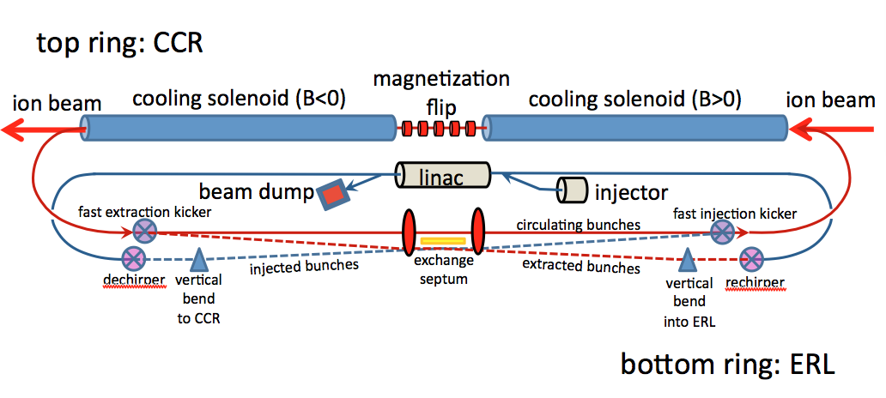
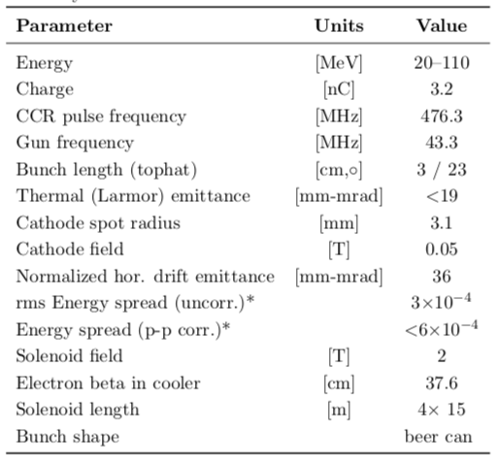
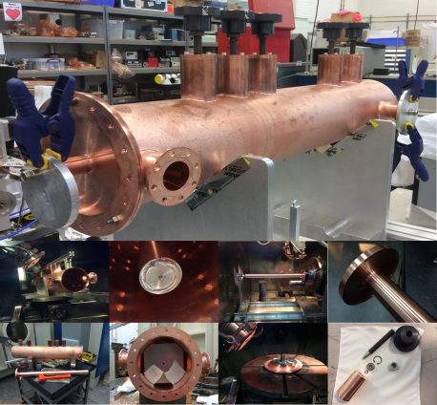
Bunched Beam Cooling
ERL cooler +
Multi-turn circulator ring
Enabling technologies :
Fast kickers, risetime <1 nsec
Magnetized source ~75mA

Slide 7
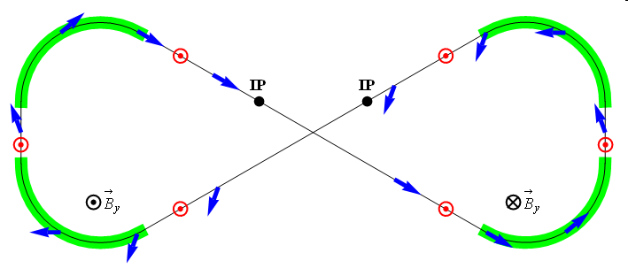
High polarization: Figure-8
Electron polarization
Figure-8 concept: spin precession in one arc is exactly cancelled in the other
Spin stabilization by small fields: ~3 Tm vs. ~ 400 Tm for deuterons at 100 GeV
Criterion: induced spin rotation >> spin rotation due to orbit errors
Highly polarized deuteron beams will run in JLEIC
3D spin rotator: combination of small rotations about different axes provides any polarization orientation at any point in the collider ring
No effect on the orbit
Adiabatic spin flips
Spin tracking in progress
Spin Rotator
Magnetic field
Polarization
IP
e⁻
E- energy (GeV) | 3 | 5 | 7 | 9 | 10
Estimated Pol. Lifetime (hours) | 66 | 5.2 | 2.2 | 1.3 | 0.8
Ion polarization
ν = 0
Polarization for proton, light ions (incl. deuterons), electrons >80%.
✔

Slide 8
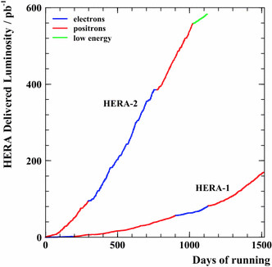
Luminosity Discussion
In HERA-2, ~600 pb⁻¹ of integrated luminosity
was delivered (to ZEUS) over ~1000 days of
running.
The means that HERA-2 delivered
~0.6 pb⁻¹/day or ~4 pb⁻¹/week of integrated
luminosity during “running”. There were two collider
experiments, so inflate this a little to 6 pb⁻¹/week
6 pb⁻¹/(one week in seconds) = 10³¹ cm⁻²s ⁻¹
This is the average luminosity of HERA while running
We would like to have 100 – 1000 times HERA luminosity:
So the aim for the EIC is 0.6 fb⁻¹ to 6 fb⁻¹/week of running.
Or average luminosity (while running) of 10³³ to 10³⁴ cm⁻² s⁻¹
6 fb⁻¹/wk ➔ 100 fb⁻¹/yr assuming 10⁷ s in year (running ~1/3 of the year
or a “snowmass” year)
average while running (not instant, not peak, etc.)
Average luminosity (while running) is quoted for JLEIC

Slide 9
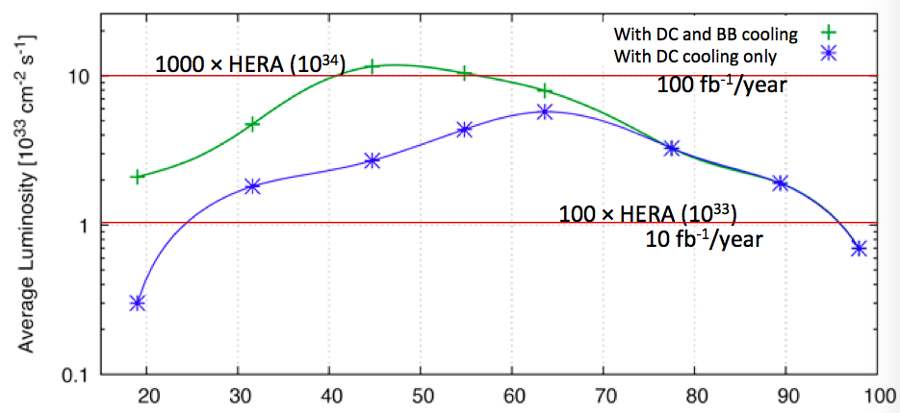
JLEIC Average Luminosity and Energy Reach
Average luminosity during running (operational inefficiency taken into account): i.e.
Integrated luminosity = Av. Lumi × Time of running
Note good perf. w DC only
Luminosity 100 to 1000 time that of HERA over the energy range
✔

Slide 10
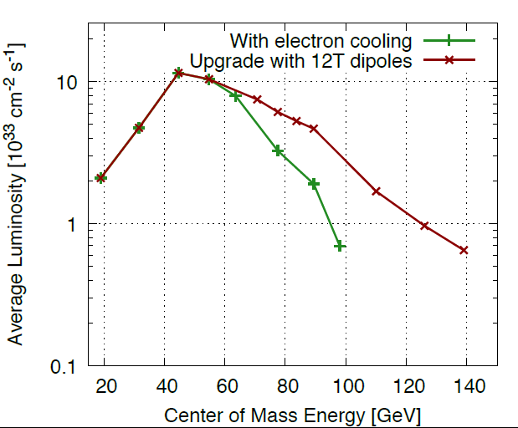
JLEIC Luminosity and Energy Reach with Upgrade
Average luminosity during operation: i.e.
Integrated luminosity = Av. Lumi × Time
Note: Total of ~640 fb⁻¹
10³⁴ cm⁻²s⁻¹  6 fb⁻¹/week,
( >100 fb⁻¹ /year)
10³³ cm⁻²s⁻¹  0.6 fb⁻¹/week,
( >10 fb⁻¹ /year)

Slide 11
JLEIC SUMMARY
The basis of the design (ring-ring, high luminosity by high rep-rate, high polarization with Figure-8, full event coverage, and minimization of technical risk) has remained constant since 2005
The energy reach is √s =20 to 100 GeV upgradable to 140 GeV, using 12 T magnet technology being developed for CERN projects HE-LHC and FCC.
The design delivers average luminosity of 10³³⁻³⁴ cm⁻² sec⁻¹ in the almost the entire energy range with only DC cooling.
The figure-8 design achieves >80% polarization for both light ions (including deuteron) and electrons.
A pre-CDR with a full description is under preparation. There may be a minor update to the parameters upon its release.
The overall design risk is low in most areas.
Technology demonstration is needed primarily for the bunched beam electron cooling; However, very good performance can be achieved with only DC cooling.
✔
✔
✔

