Slide 1
Firestorm
Würzburg, March 16, 1945
Manhattan Project
Hamburg, July 1943
Dresden, February 13, 1945
Technique
Markers/flares/”mosquitos”
Concussion bombs (n = 256)
Incendiary bombs (n = 307,650)
Achievement
Science
Industrial production
Organizational management
“Historical Identification” = Firestorm

Slide 2
Firestorm
Würzburg, March 16, 1945

Slide 3
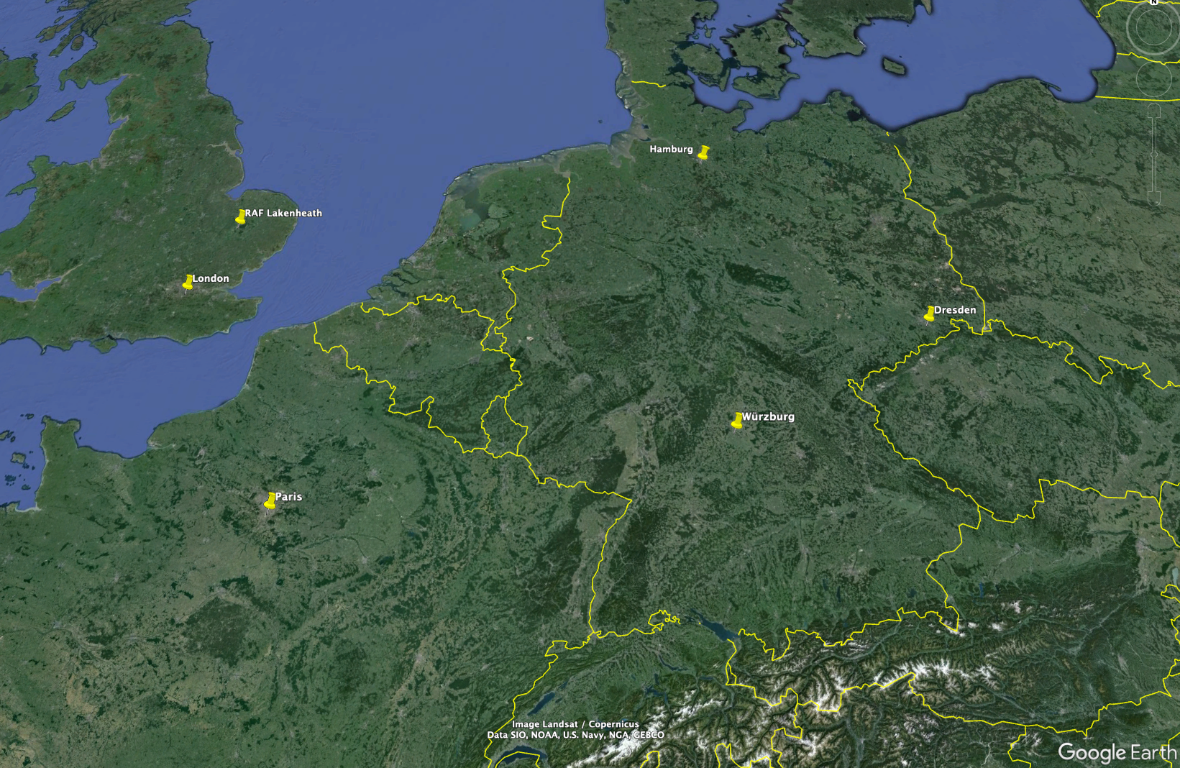
Firestorm
Würzburg, March 16, 1945
Manhattan Project
Hamburg, July 1943
Dresden, February 13, 1945

Slide 4
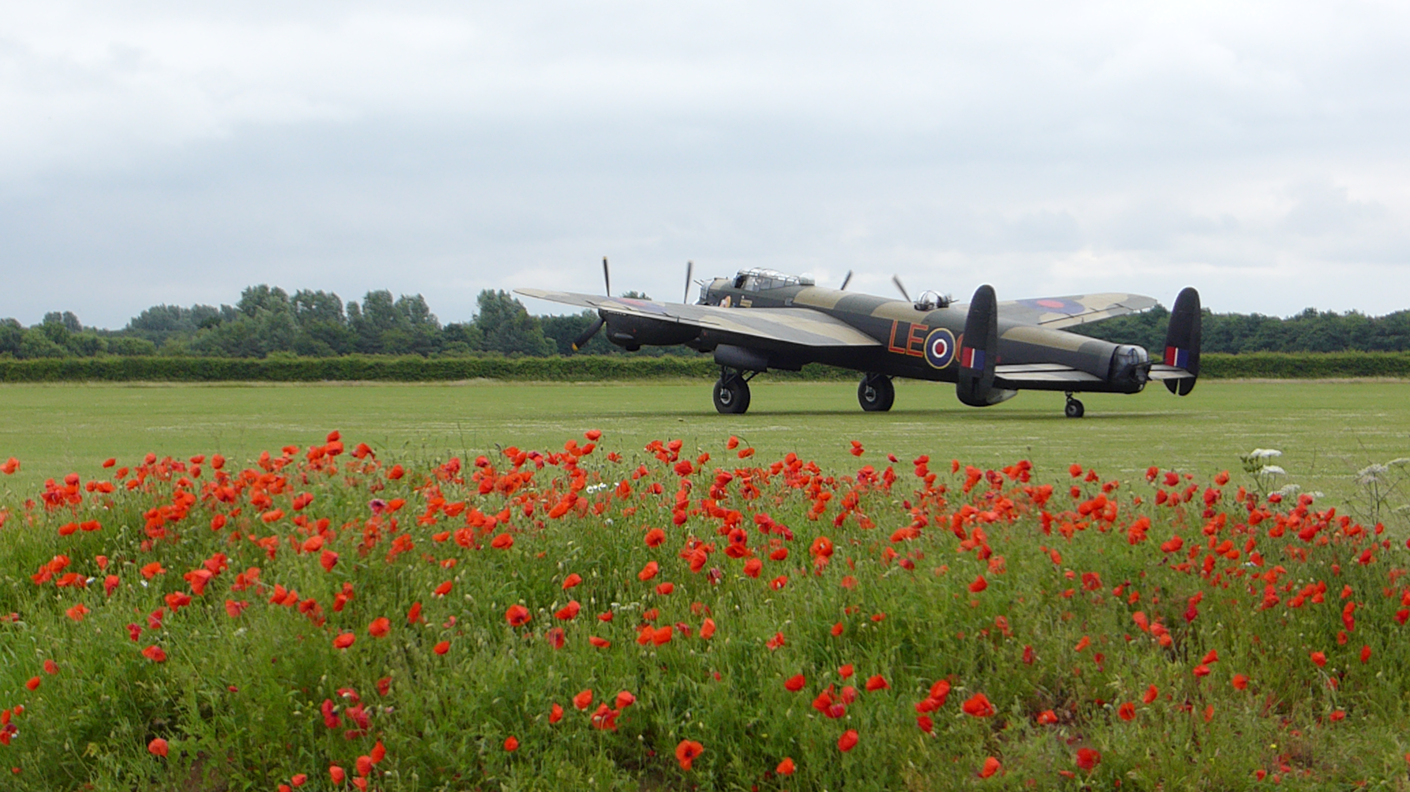
Firestorm
Würzburg, March 16, 1945
Manhattan Project
Hamburg, July 1943
Dresden, February 13, 1945
Avro Lancaster
(Flanders poppies in foreground)
Lincolnshire Aviation Heritage Museum, East Kirkby
https://630squadron.wordpress.com/introduction/

Slide 5
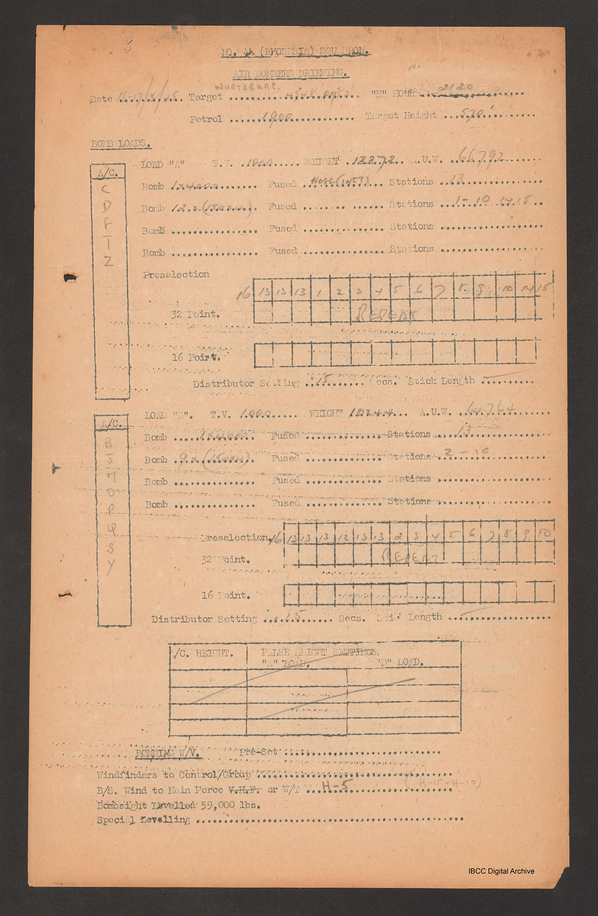
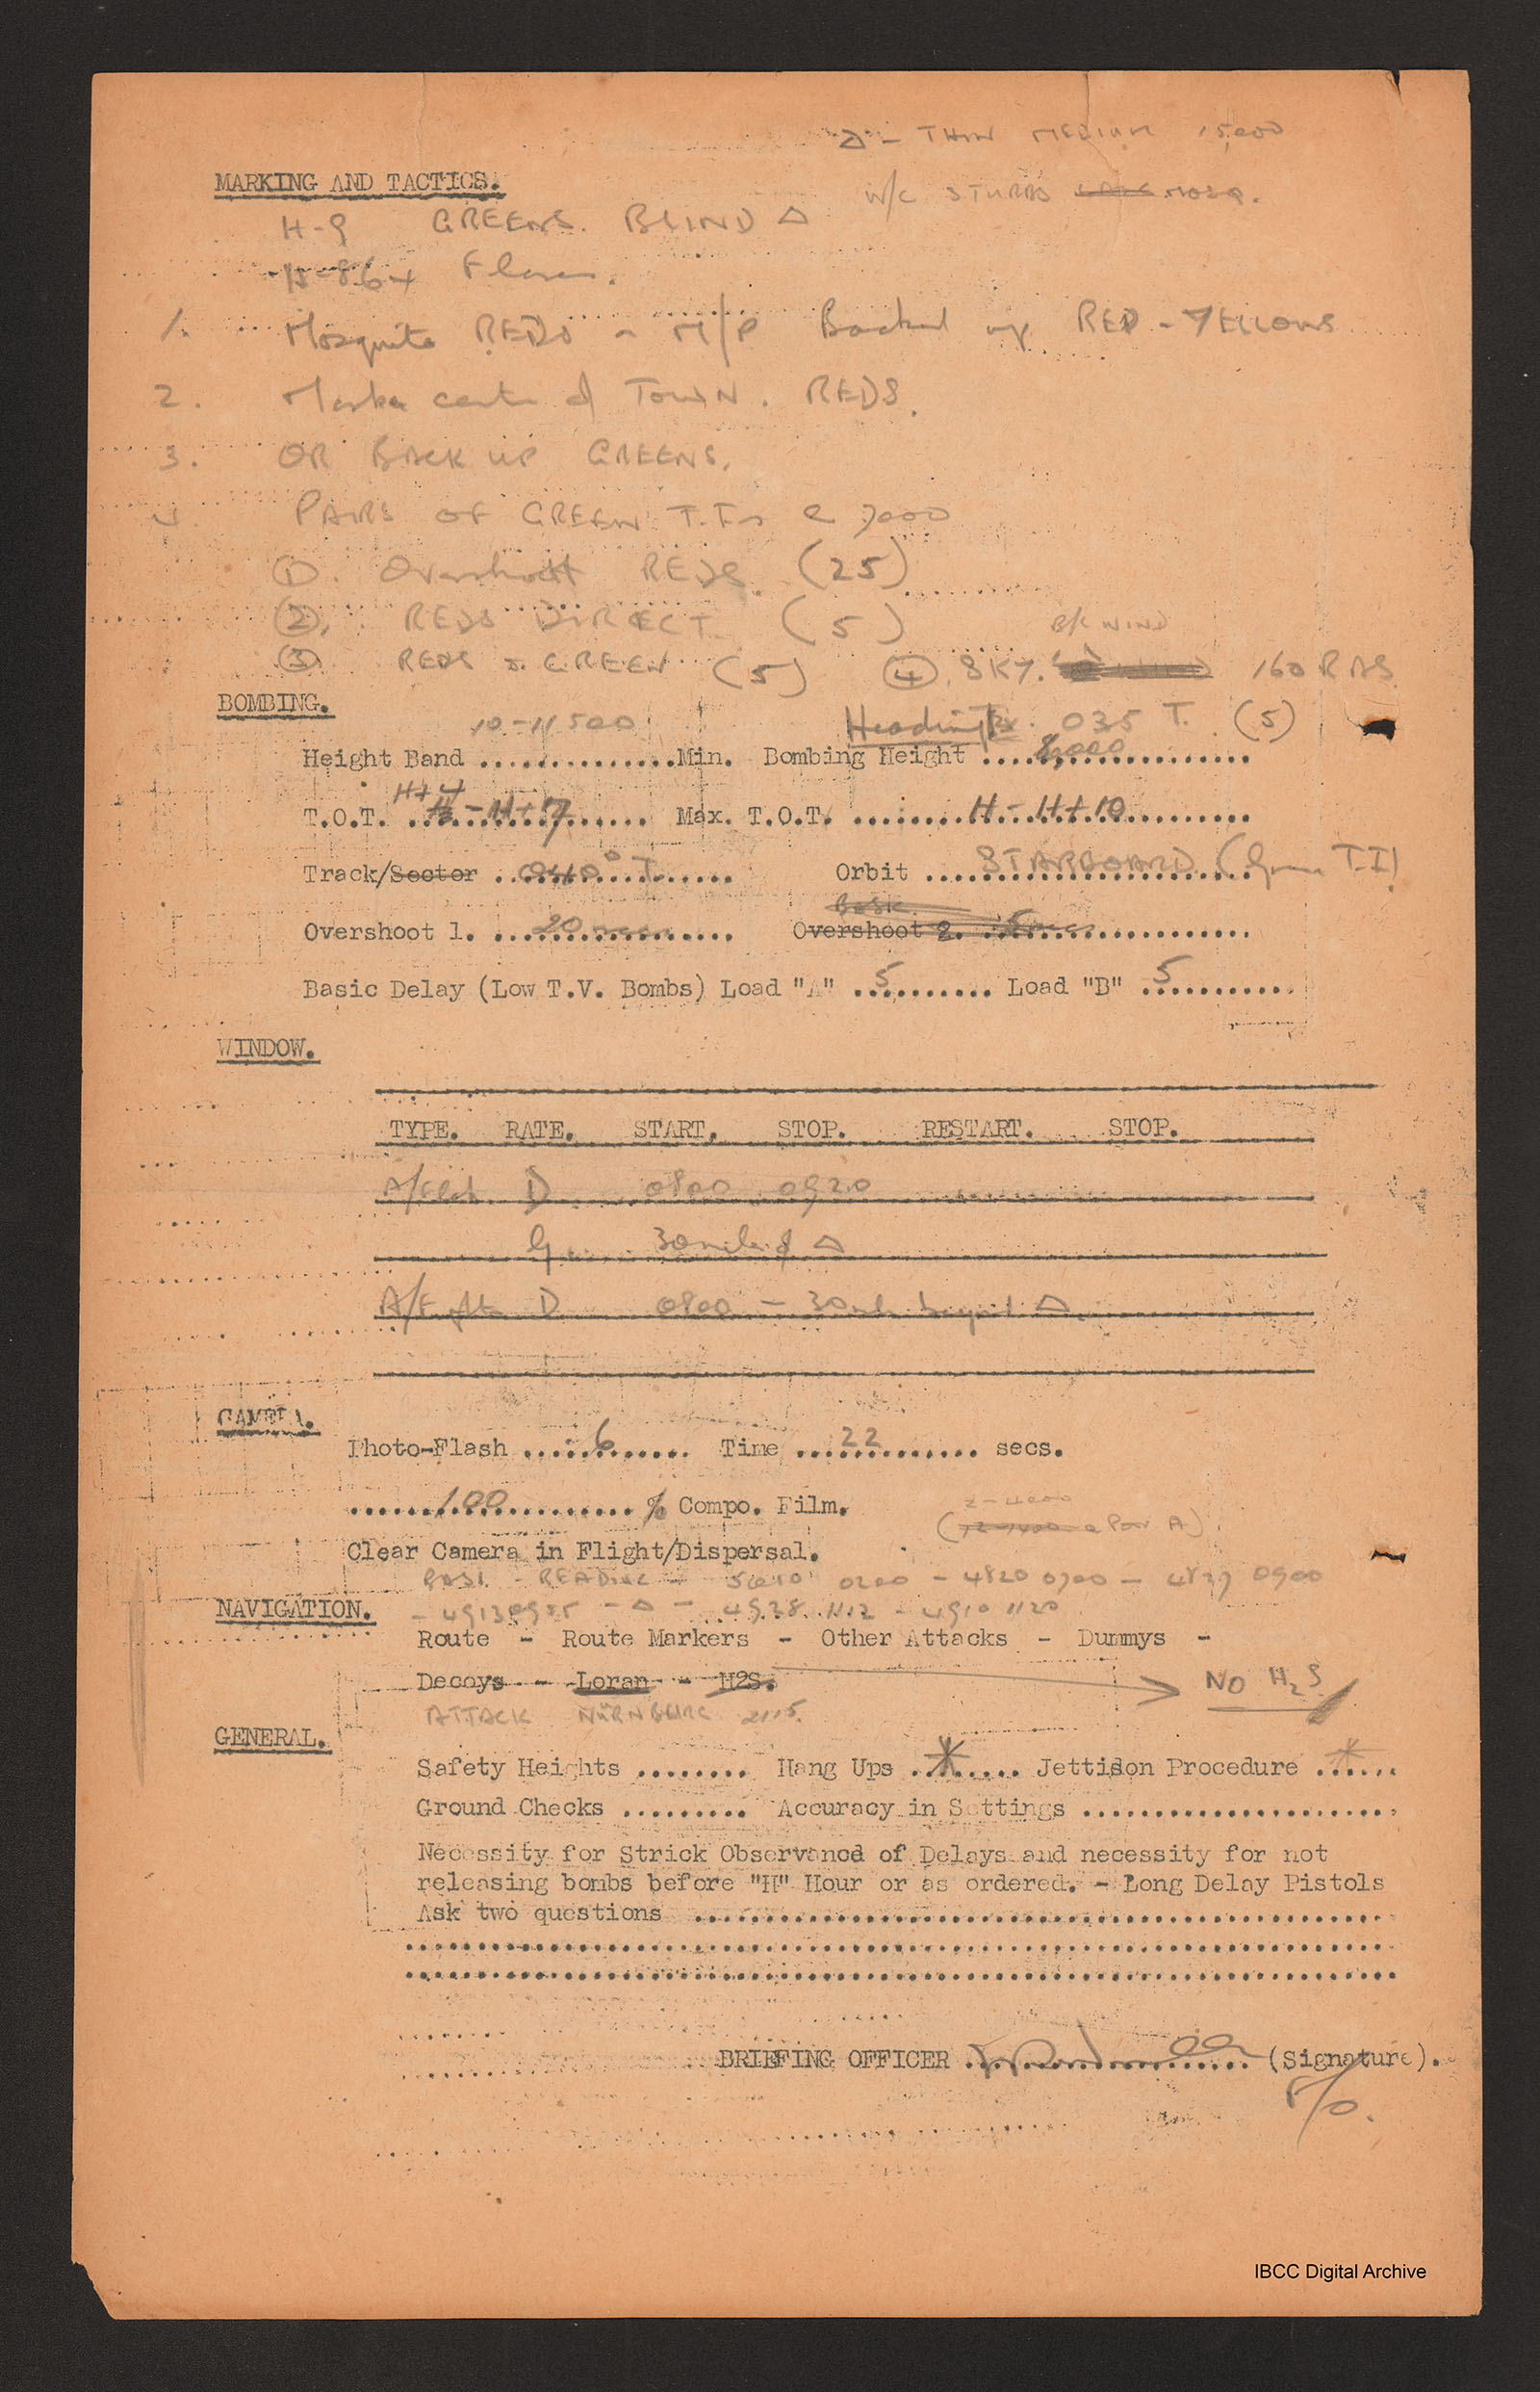
Firestorm
Würzburg, March 16, 1945
Manhattan Project
Hamburg, July 1943
Dresden, February 13, 1945
Technique
Markers/flares/”mosquitos”
Concussion bombs (n = 256)
Incendiary bombs (n = 307,650)
“Bomb aimers briefing 16/17 March 1945 - Wurtzburg,” IBCC Digital Archive, https://ibccdigitalarchive.lincoln.ac.uk/omeka/collections/document/7232.

Slide 6
Firestorm
Würzburg, March 16, 1945
Manhattan Project
Hamburg, July 1943
Dresden, February 13, 1945
Technique
Markers/flares/”mosquitos”
Concussion bombs (n = 256)
Incendiary bombs (n = 307,650)
Achievement
Science
Industrial production
Organizational management

Slide 7
Firestorm
Würzburg, March 16, 1945
Manhattan Project
Hamburg, July 1943
Dresden, February 13, 1945
Technique
Markers/flares/”mosquitos”
Concussion bombs (n = 256)
Incendiary bombs (n = 307,650)
Achievement
Science
Industrial production
Organizational management
“Historical Identification” = Firestorm

