Slide 1


JLab 12 GeV Upgrade Status
Rolf Ent
JLab User Satellite Meeting @ DNP2012
October 25, 2012

Slide 2
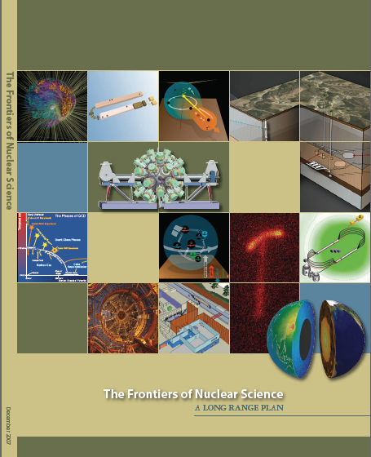
12 GeV Upgrade Project
Upgrade is designed to build on existing facility: vast majority of accelerator and experimental equipment have continued use
New Hall
Upgrade arc magnets
and supplies
Add 5 cryomodules
20 cryomodules
CHL upgrade
Maintain capability to deliver lower pass beam energies: 2.2, 4.4, 6.6….
Add arc
20 cryomodules
The completion of the 12 GeV Upgrade of CEBAF was ranked the highest priority in the 2007 NSAC Long Range Plan.
Add 5 cryomodules
Scope of the project includes:
Doubling the accelerator beam energy
New experimental Hall and beamline
Upgrades to existing Experimental Halls
Enhanced capabilities
in existing Halls

Slide 3
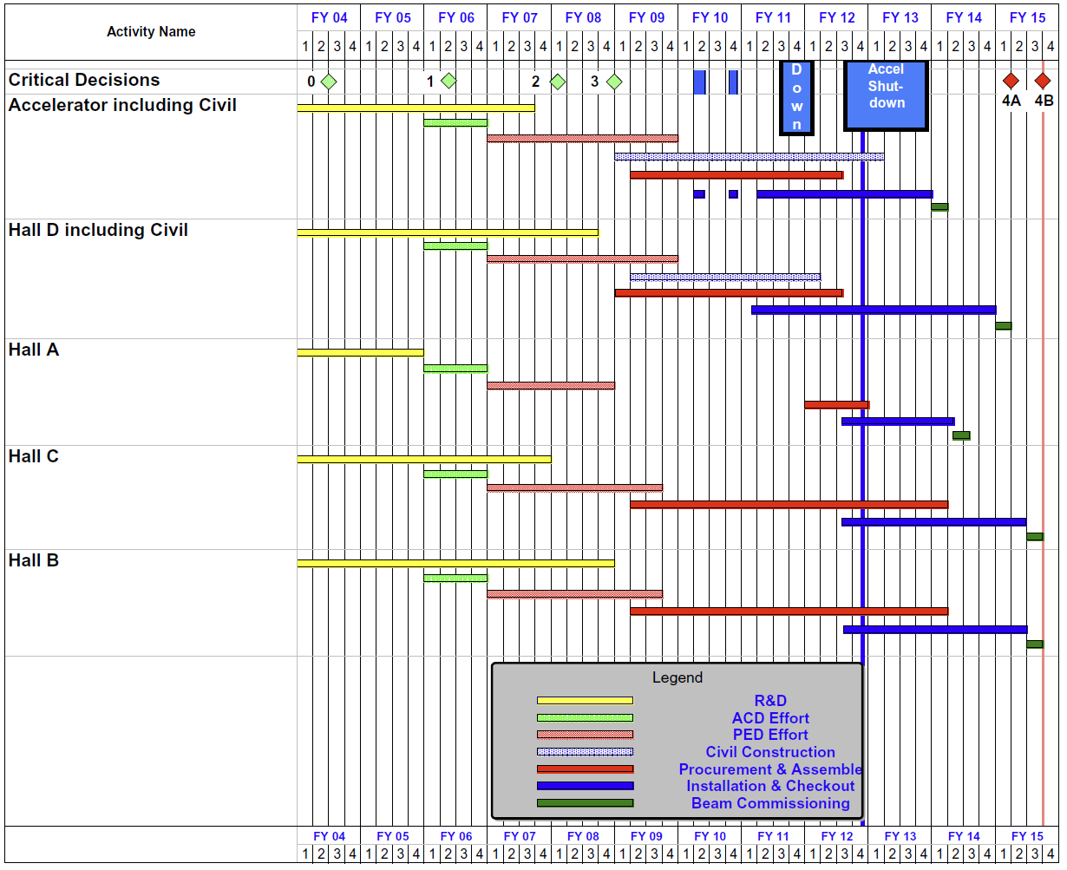
12 GeV UPGRADE PROJECT SCHEDULE
    Two short parasitic installation periods in FY2010
    6-month installation
    May-Oct 2011
    12 16-month installation
    May 2012 - May Sept 2013
    Hall A commissioning start Oct 2013 Feb 2014
    Hall D commissioning start
    April 2014 Oct 2014
    Halls B & C commissioning start Oct 2014 Apr 2015
    Project Completion June 2015
    (pending rebaseline)

Slide 4
Progress Highlights
Construction (as of 30-Sept-2012)
  Civil: ~93% complete
  Accelerator: ~84% complete
  Physics - Hall D: ~53% complete
  Physics – Halls A/B/C: ~43% complete
Funding Delays
  FY12 - $50M received, $16M cut from $66M planned
  FY13 – $43M, No restore
    Rebaseline project – November 2012
  FY14 – $30M, $12M restored (tbd)
DOE Obligated (%)

Slide 5
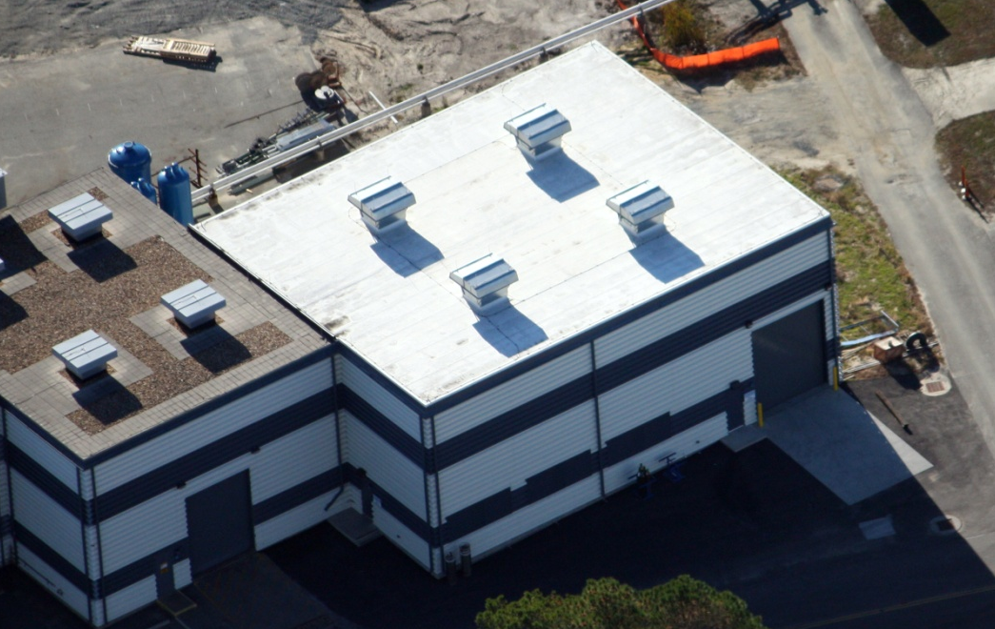
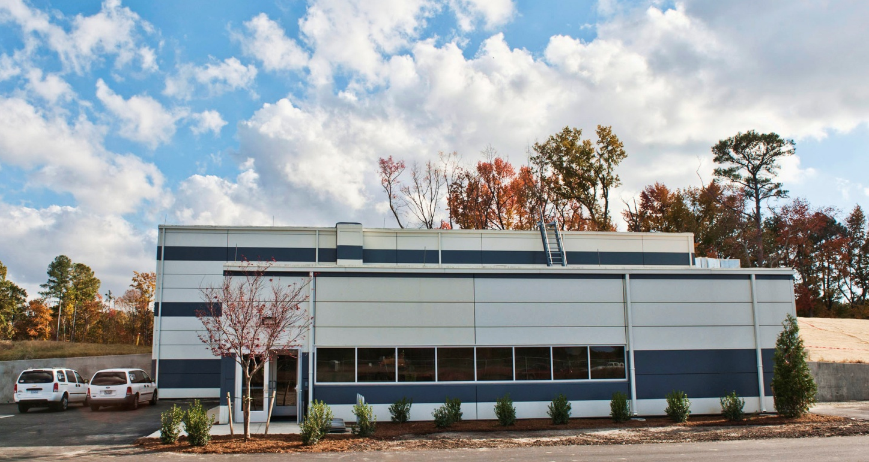
Civil Construction is Basically Complete
One minor FY13 task remains.
Two minor FY14 tasks remain.
Hall D Counting House
Central Helium Liquefier
Building Addition

Slide 6
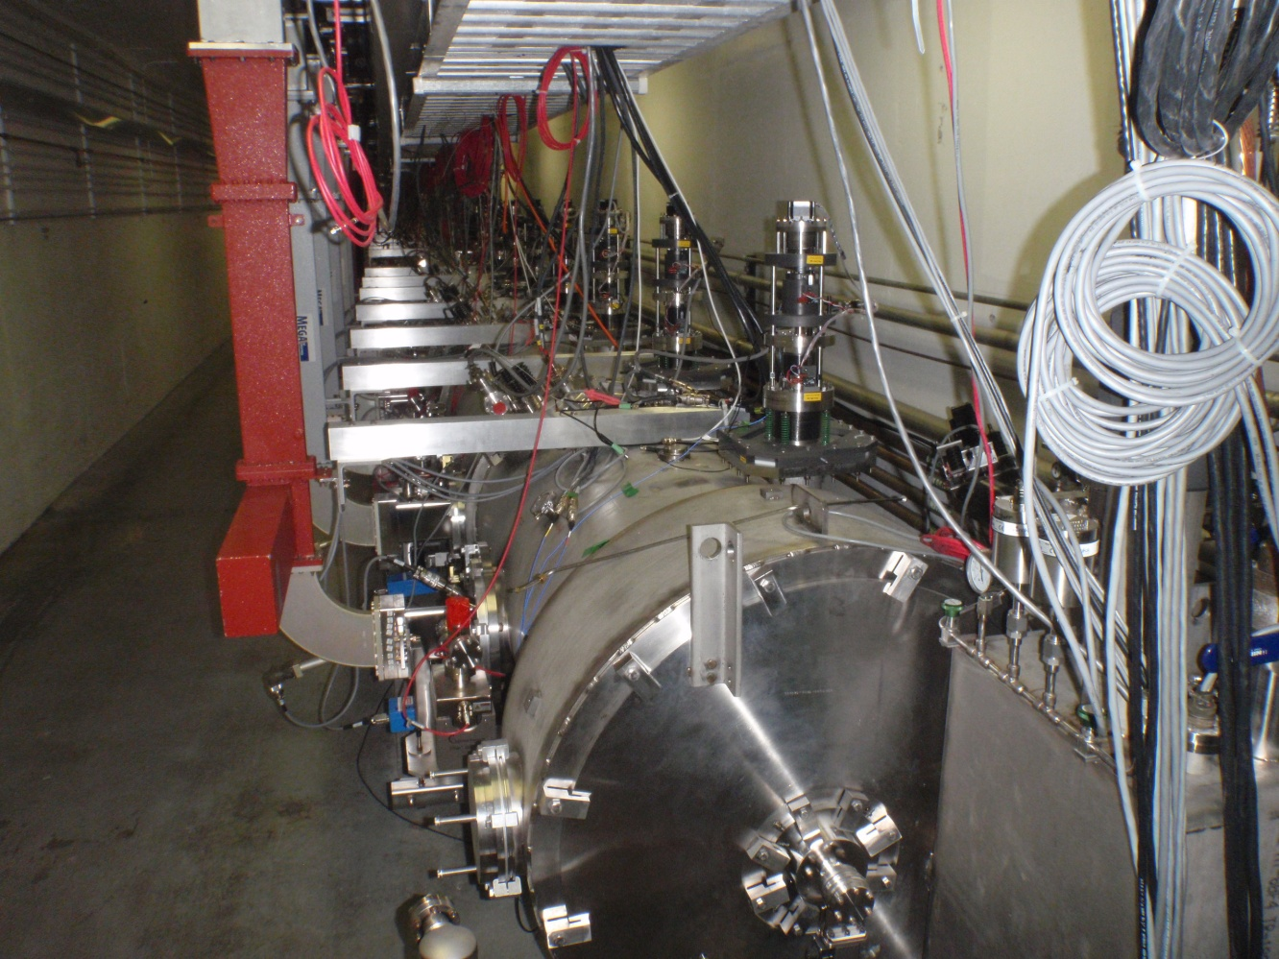
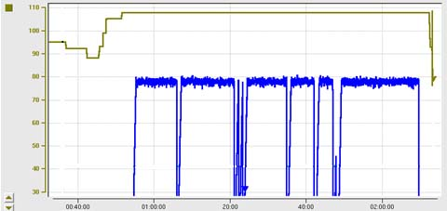
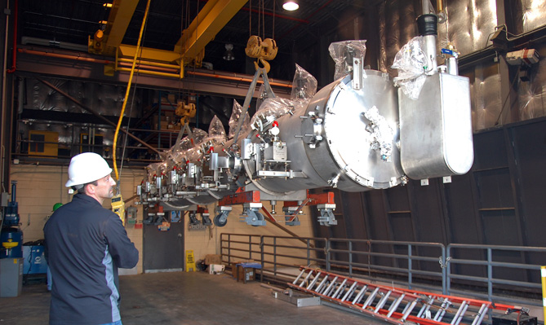
Accelerator - Highlights
4 of the 10 new Cryomodules are installed and commissioned
  Achieved 108%, 110%, 107% and 111% of 12 GeV gradients
2 additional Cryomodules are in the tunnel awaiting installation.
Last 4 cavity strings are complete.
C100 Cryomodule Energy Gain – May 18th
108 MeV
– 200
98 MeV
– 150
ENERGY GAIN (MeV)
Beam Current/pass (μA)
– 100
– 50
Third C100 Cryomodule being transferred to tunnel

Slide 7
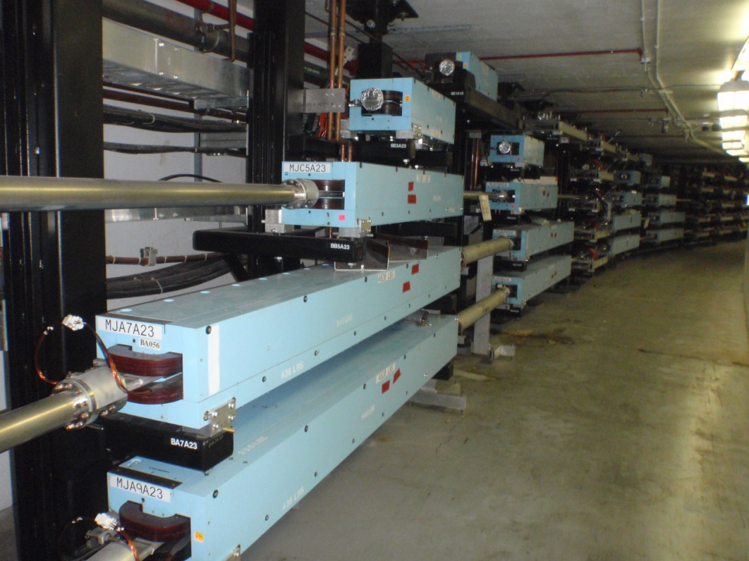
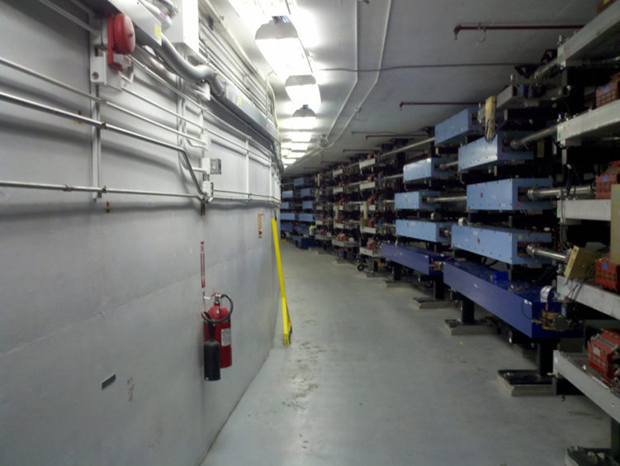
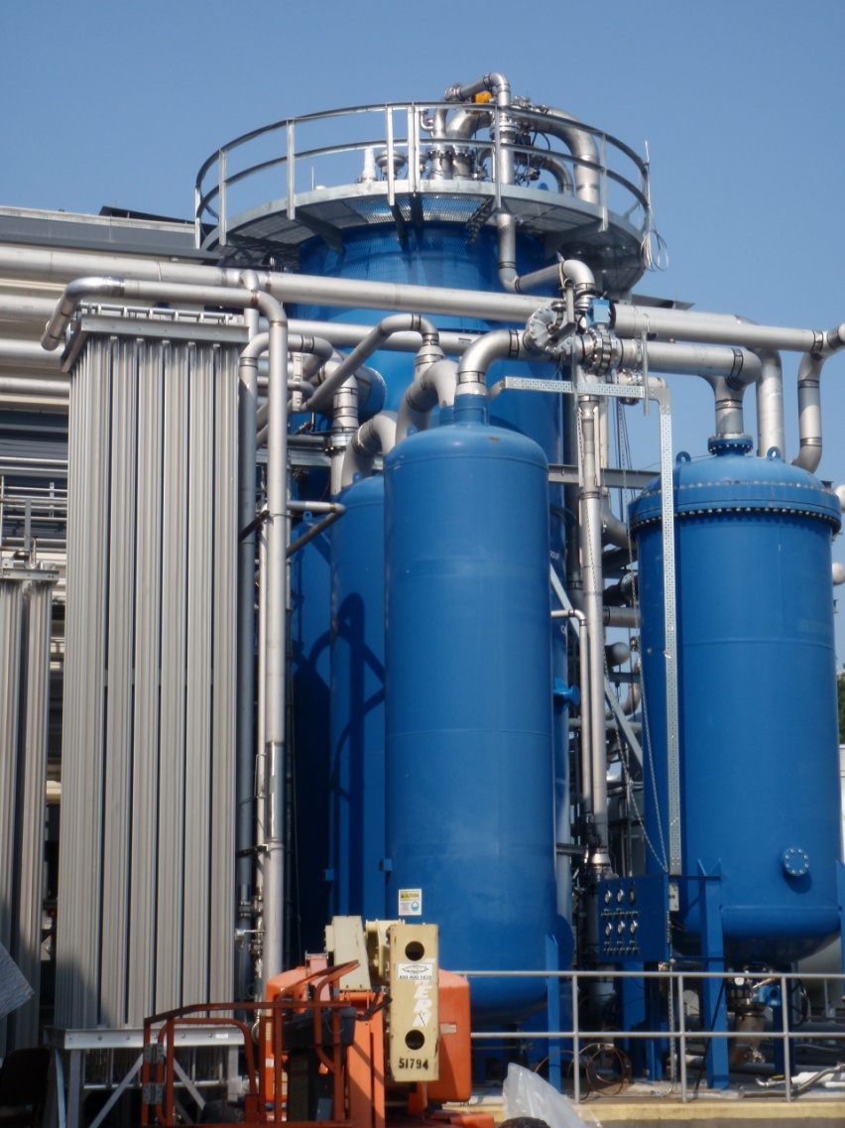
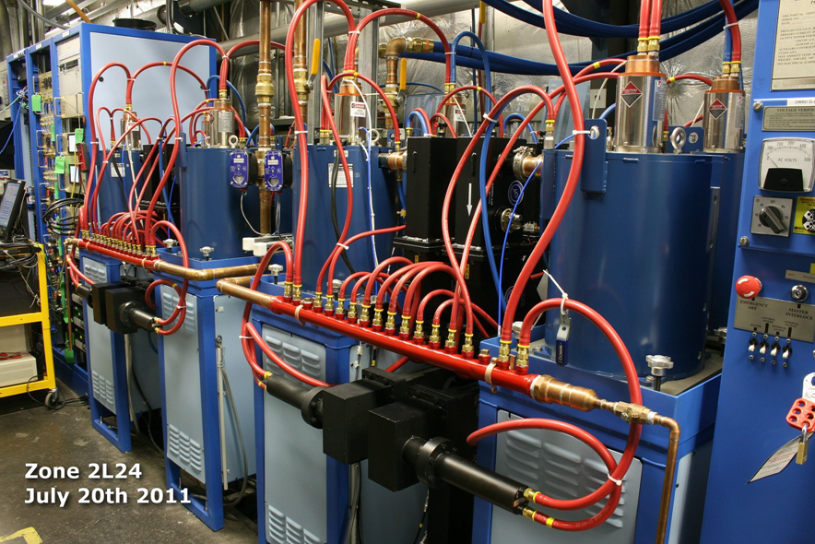
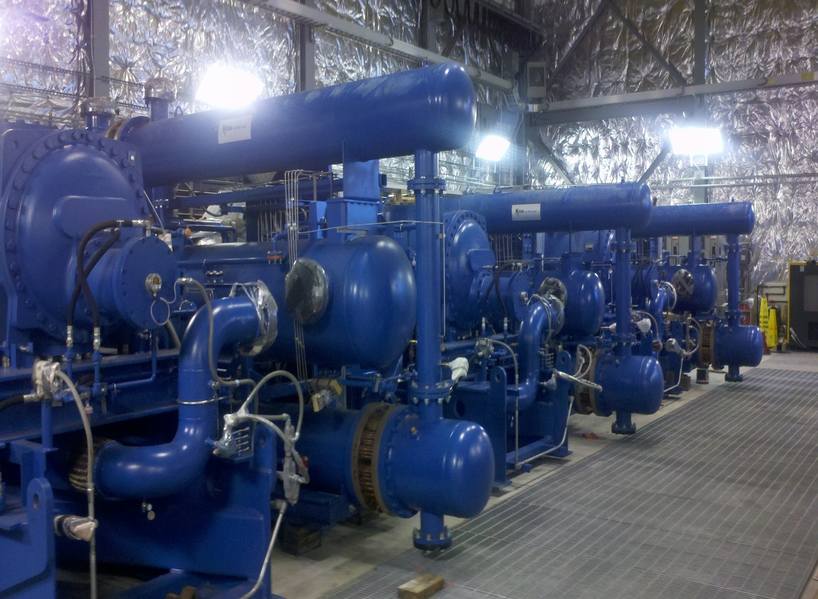
Accelerator - Highlights
The last of 9 existing accelerator Magnet arcs is being refurbished and upgraded from “C” to “H” magnets. The new Arc 10 for beam to Hall D has been installed.
East ARC
West ARC
CHL-2 Refrigerator system being installed and commissioned.
>50% of RF system operational.

Slide 8
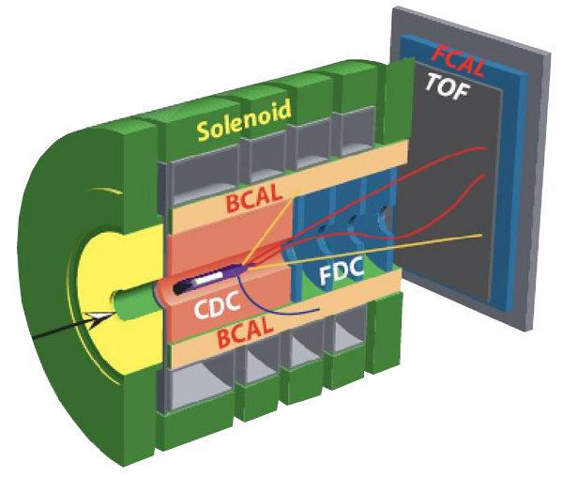
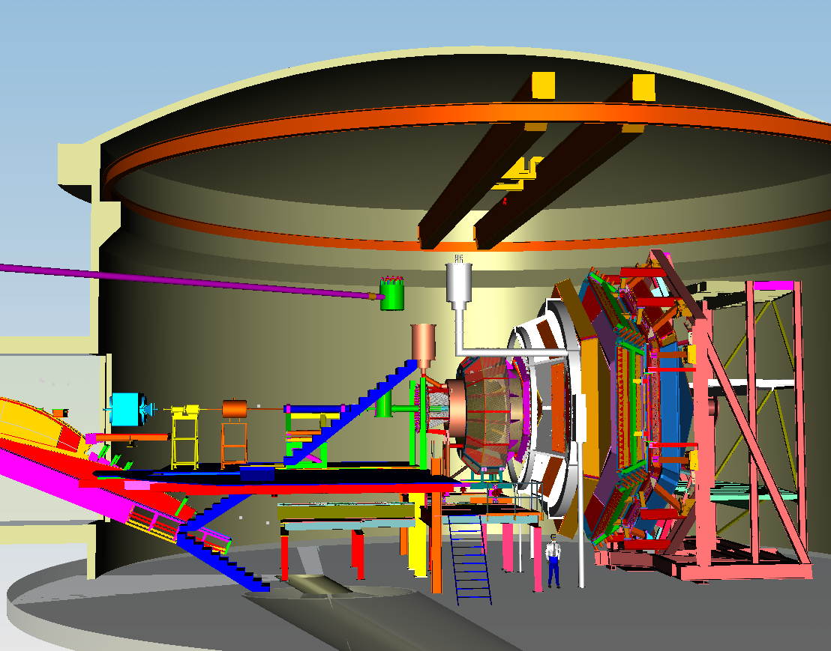
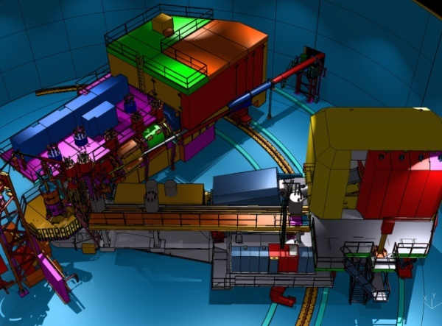

12 GeV Upgrade Physics Instrumentation
GLUEx (Hall D): exploring origin of confinement by studying hybrid mesons
CLAS12 (Hall B): understanding nucleon structure via generalized parton distributions
SHMS (Hall C): precision determination of
valence quark properties in nucleons and nuclei
Hall A: nucleon form factors,
& future new experiments like Moller & SOLID
Notes:
Note BSM not included in project

Slide 9
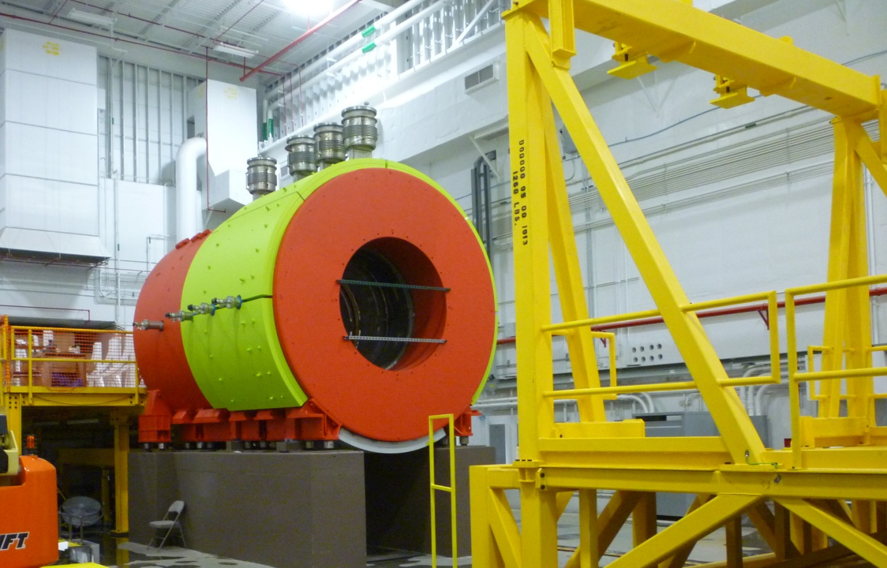
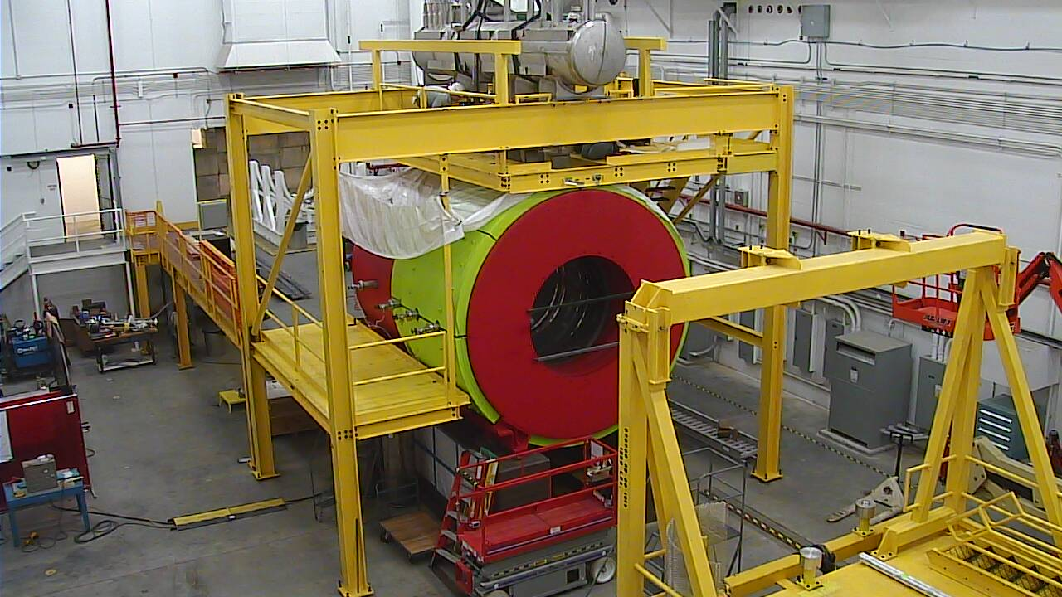
Physics – Hall D
Hall D Solenoid installed:
  Cryogenic connections in progress
  Cool-down planned for December followed by testing
August 2012 – with cryo cans
October 2012 – with platform & valve box

Slide 10
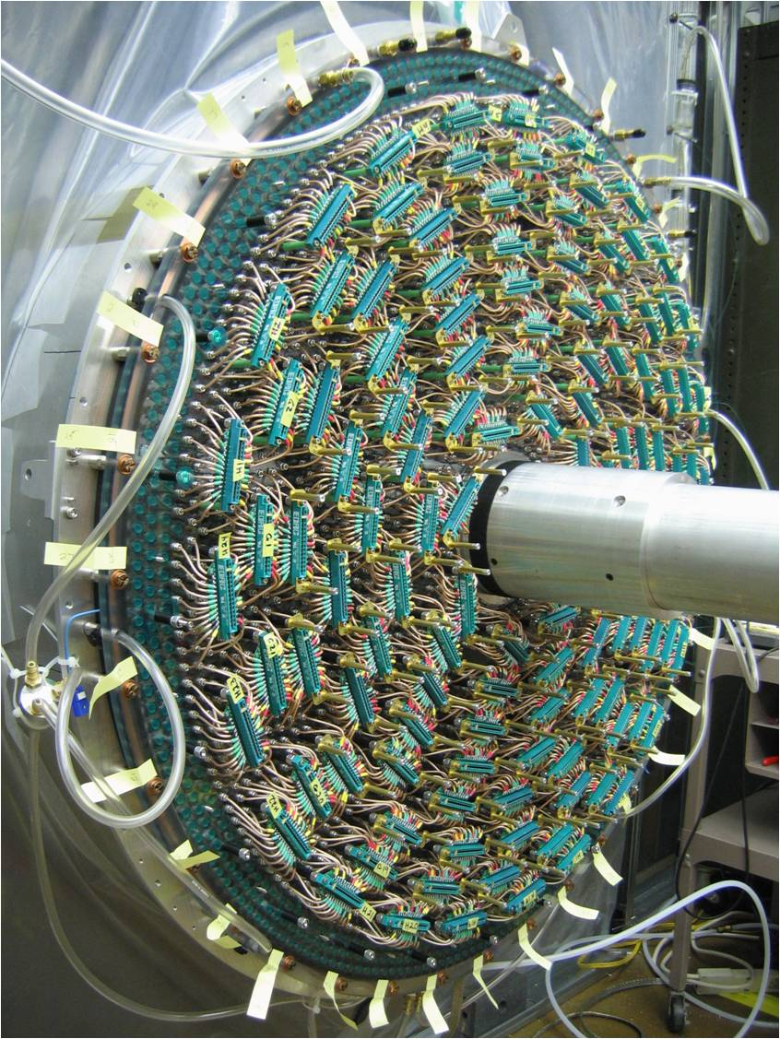
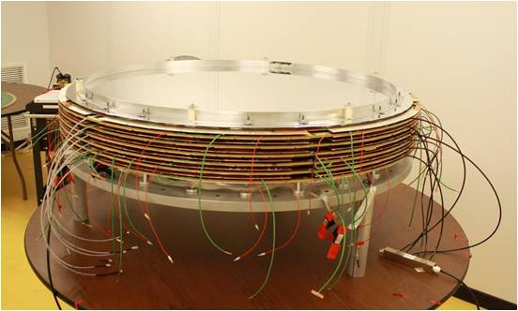
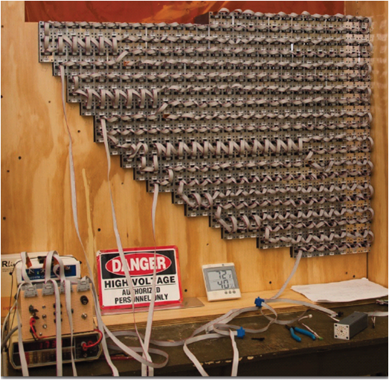
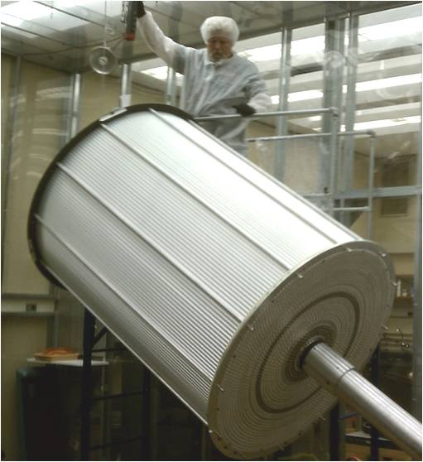
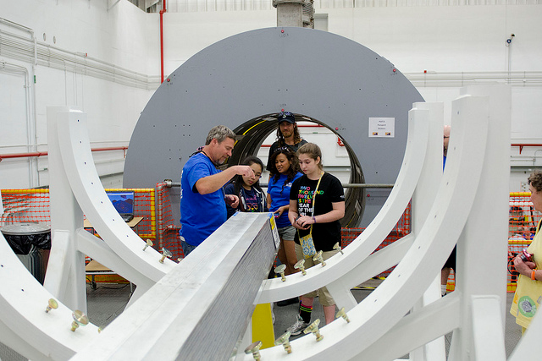
Physics – Hall D (Continued)
DETECTOR
FDC
(JLab)
FCAL
(Indiana U.)
BCAL Module (U. Regina) as shown at
JLab open house
CDC
(Carnegie Mellon U.)

Slide 11
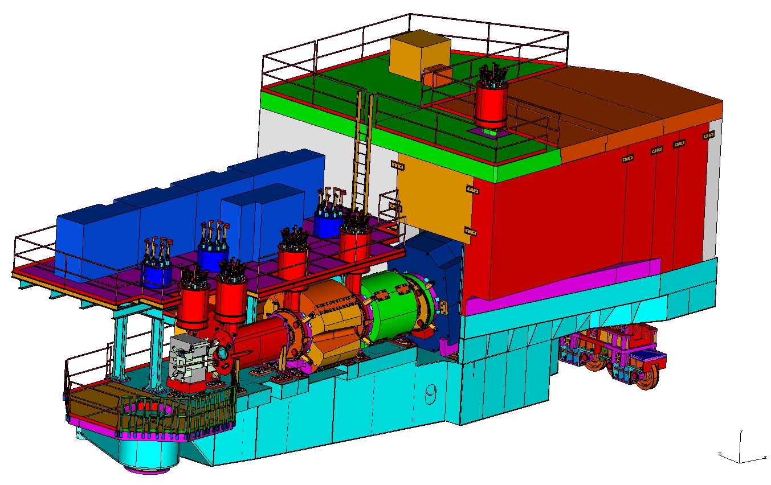
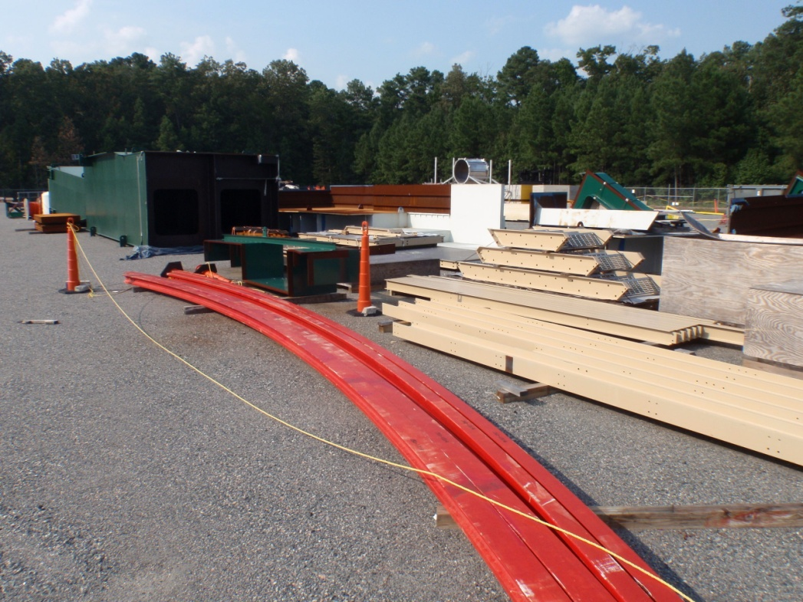
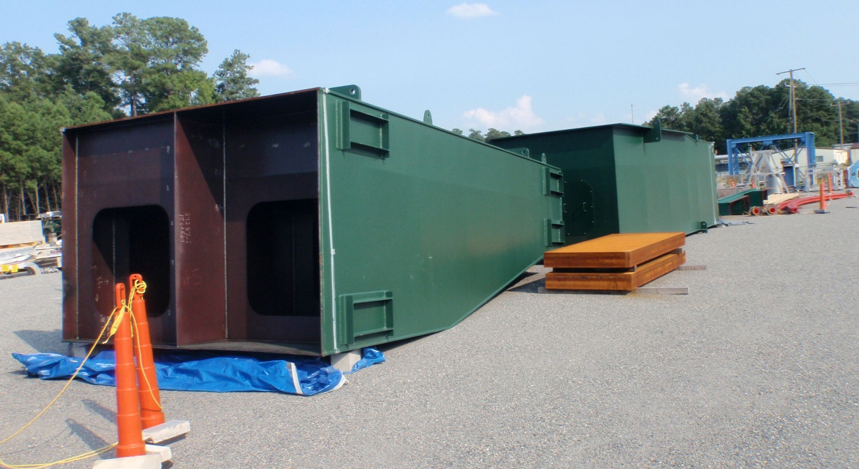
Physics – Hall C Spectrometer
Most detectors provided through non-US funding and NSF MRI grants – All in production
(CUA, FIU, Hampton, JMU, NCA&T, Regina, UVa, W&M, Yerevan)
D
Q2
Q3
Spectrometer support carriage parts have all arrived.
Q1
HB

Slide 12
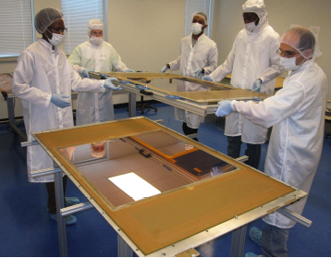
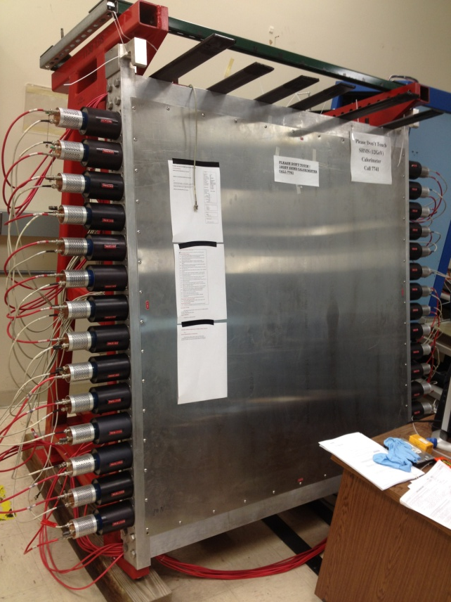
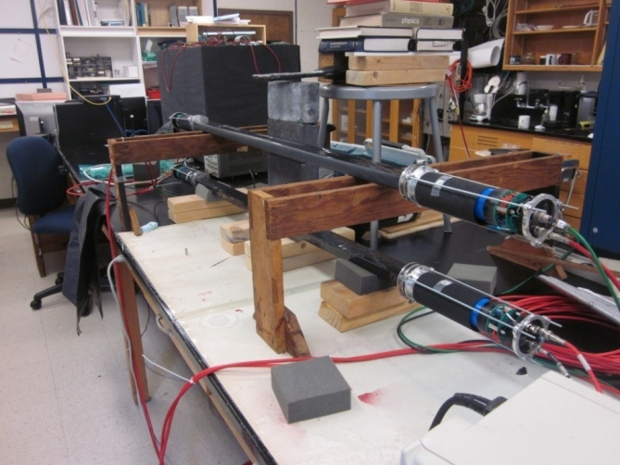
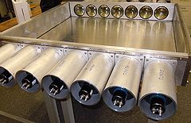
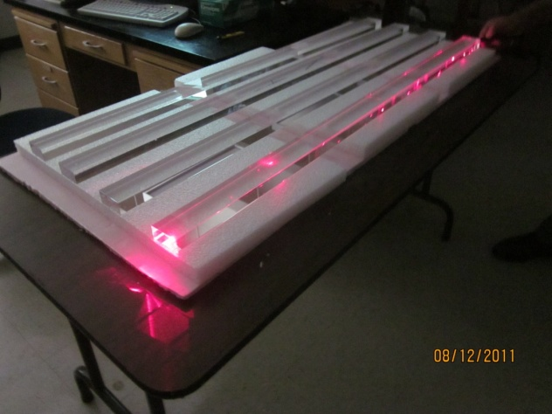
Physics – Hall C (Continued)
DETECTOR
Pre-Shower
(Yerevan)
Wire Chambers
(Hampton)
Quartz Hodoscope
(NCA&T)
Aerogel Detectors
(CUA)

Slide 13
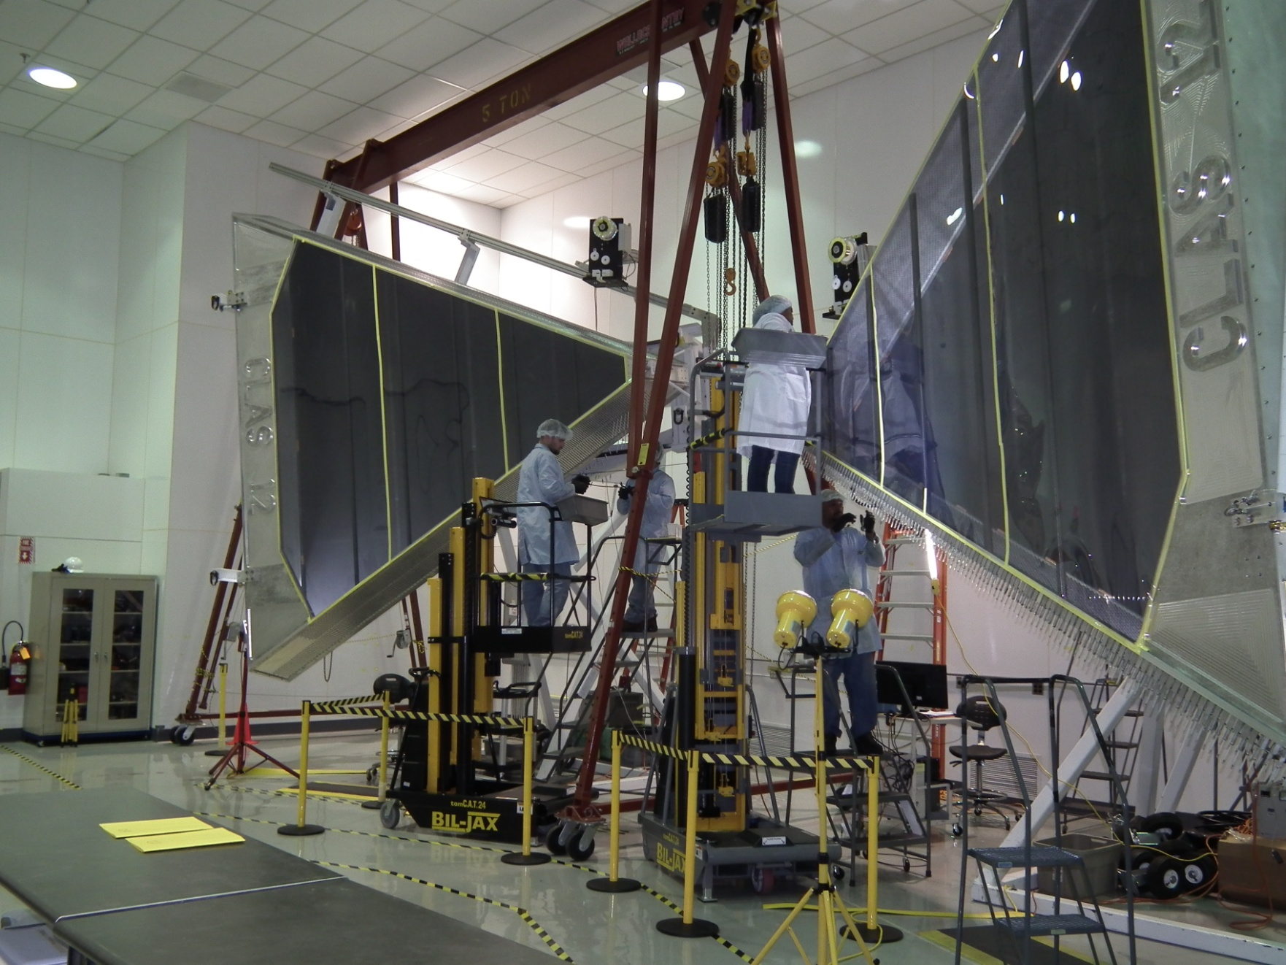
Hall B DC – Stringing and testing in full swing
(JLab & Old Dominion & Idaho State)
9 of 18 Chambers complete; 3 additional in progress.

Slide 14
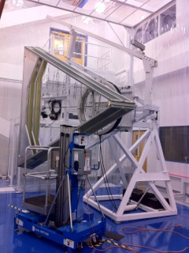
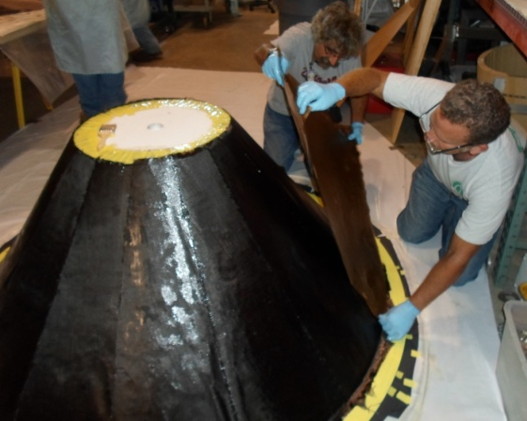
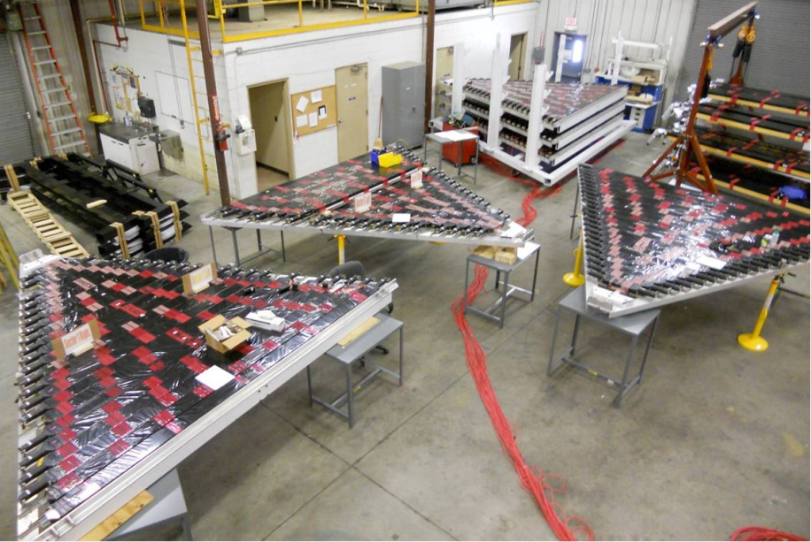
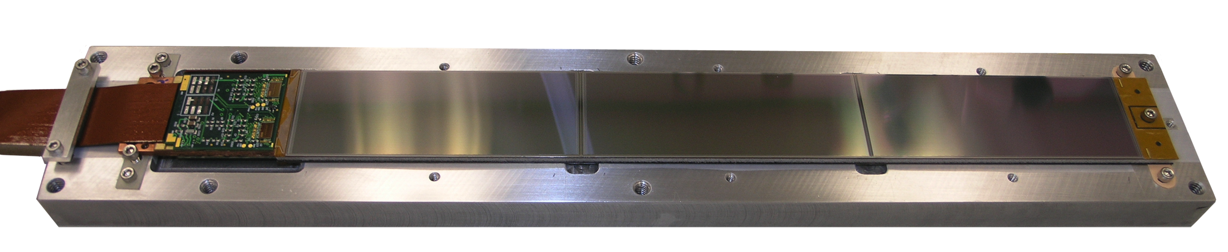
Physics – Hall B (Continued)
PCAL (JLab/Ohio/W&M/NSU/JMU)
DETECTOR
FTOF panels refurbished for use as FTOF1-a (JLab/USC)
HTCC Entry Cone
(JLab)
Region 2 Drift Chamber
(Old Dominion U.)
Silicon Vertex Tracker
(JLab/FNAL/UNH)

Slide 15
Magnet Challenges
The Project has eight large superconducting spectrometer magnets.
Schedule continues to be a major challenge.
The Hall D Solenoid is installed waiting for the cryogenics connection; cooldown and power tests this winter.
The Halls B & C magnets start to arrive in 1QFY14 and the last ones in 1QFY15.

Slide 16
FY13 & FY14
No FY12 Funds were restored in FY13
  This is forcing us to rebaseline the project
  A rebaselining review is scheduled for Nov 27-29, 2012.
FY14 we are expecting to receive ~$12M of the FY12 $16M reduction restored
Adjusted 12 GeV Beam Delivery Goals
Hall A: 2QFY14 (1Q Slip)
  Driven by Long Shutdown
Hall D: 1QFY15 (2Q Slip)
  Driven by Long Shutdown
Halls B & C: 3QFY15 (2Q Slip)
  Driven by FY12 & 13 Funding
  Driven by magnet deliveries

Slide 17
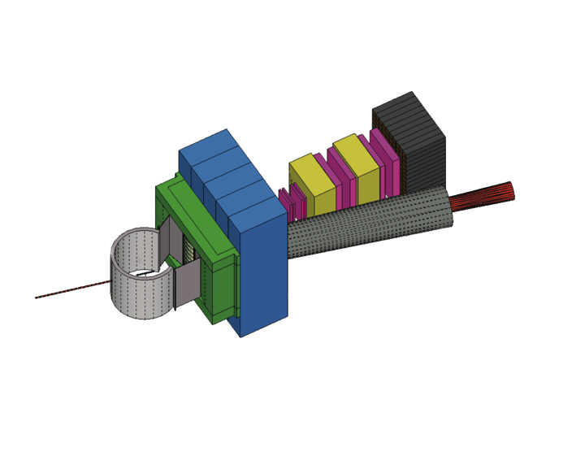
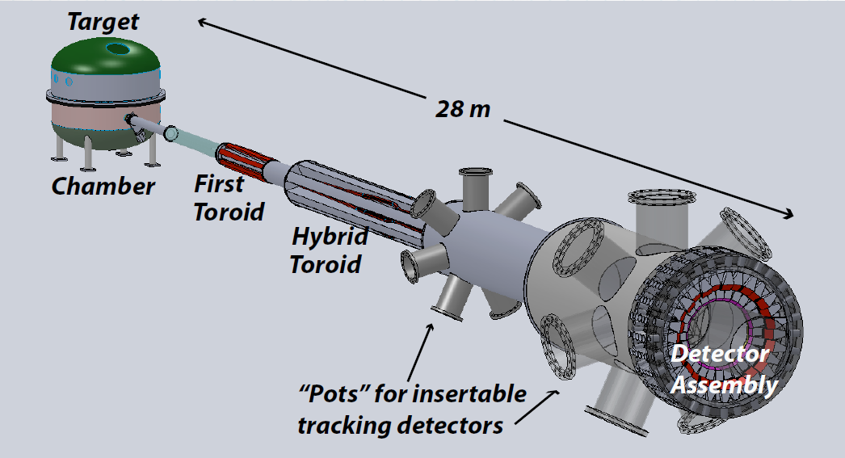

Beyond 12 GeV Upgrade
Super BigBite Spectrometer
(Approved for FY13-16 construction)
- high Q² form factors
- SIDIS
MOLLER experiment
(MIE – FY14-18?)
- Standard Model Test
SoLID
Chinese collaboration
CLEO Solenoid?

Slide 18
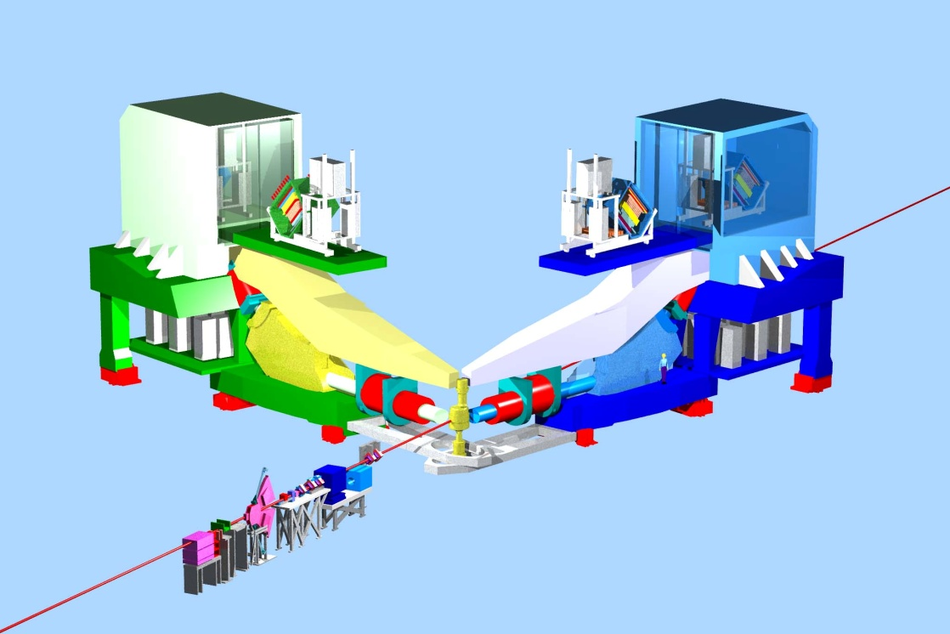
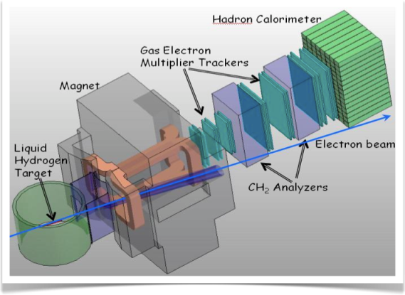
Preliminary Plans for
Early Beam in Hall A
3 A-rated experiments in first years of running
G_{M}^{p} (HRS-R) and DVCS (HRS-L + calo) run is combined
Some flexibility incorporated
16 mo. Shutdown
12 GeV Commissioning
Early Experiments
G_{M}^{p} and DVCS-I
³H/³He PREX (A1n)
EM Form Factor
Access to GPDs
d/u at High x
Neutron skin
Neutron spin structure
SBS Experiments
12 GeV Projects:
1. Moller polarimeter
2. Compton polarimeter
3. Energy Meas. upgrade
EM Form Factors
at high Q²
SBS Project
SuperBigbite
11 GeV
Beam 1st to Hall A
FY 2013
FY 2014
FY 2015
FY 2016
FY 2017

Slide 19
Preliminary Plans for
First Years of Beam in Hall B
6 A rated experiments in first 3 years of running
PCR, HPS, pDVCS, nDVCS, pSIDIS, g₁^{p}/g₁^{n}
High discovery potential during first year
CLAS12
Construction
Installation
Early 11 GeV Experiments
< 6 GeV beam
pDVCS
& GPDs
pSIDIS &
TMDs
nDVCS
& GPDs
nSIDIS
& TMDs
g₁^{p} , g₁^{n}
large x
spin str.
Proton TMDs Transverse spin structure
Proton
Charge Radius
Heavy
Photon
Search
Installation
1st beam to Hall B
First 11 GeV
FY 2014
FY 2015
FY 2016
FY 2017
FY 2018

Slide 20
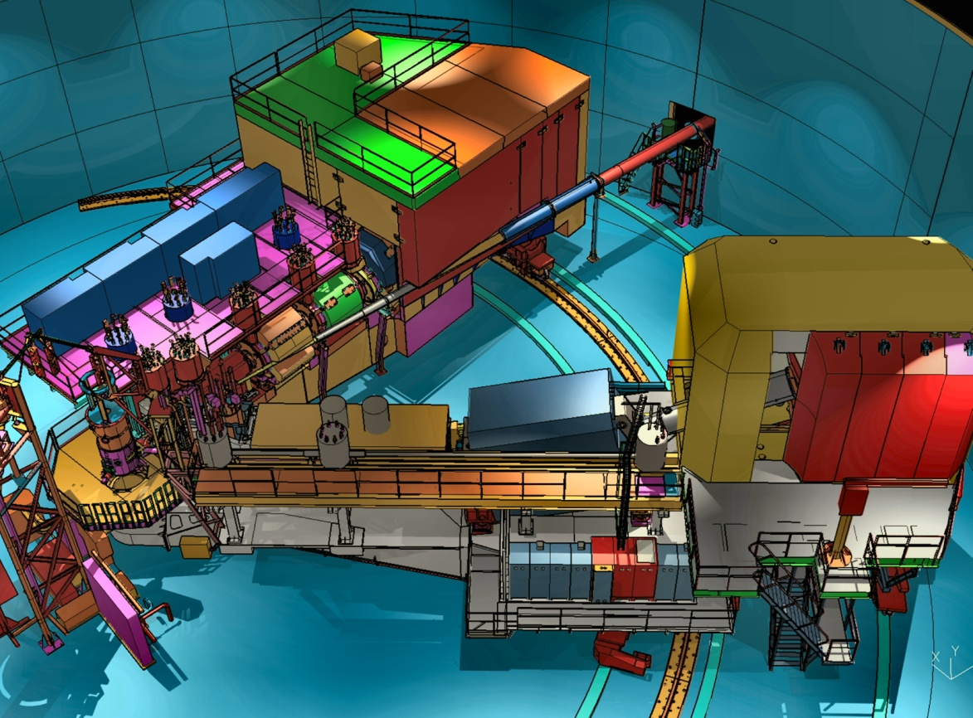
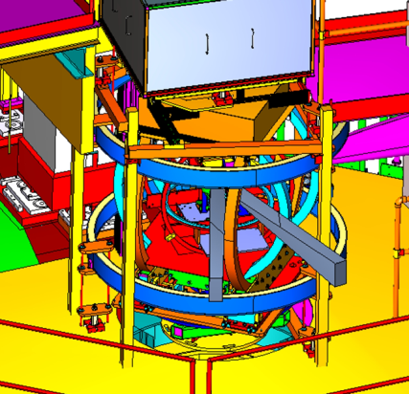
Plans for Early Beam in Hall C
Straightforward “commissioning experiments”
Basic SIDIS and easiest L/T separation
Base equipment in early years
SHMS Installation
12 GeV Commissioning
Early Experiments
p, d,A(e,e’), A(e,e’p), d(e,e’p)
Pt, CSV, (e,e’K) d2n, A1n
High x nucleon structure
Short Range nuclear structure
Basic SIDIS Xsections
Charge Sym. Violation
Exclusive Kaon Production
Neutron Spin Structure
Polarized ³He Experiments
Beam to Hall C
FY 2014
FY 2015
FY 2016
FY 2017
FY 2018

Slide 21
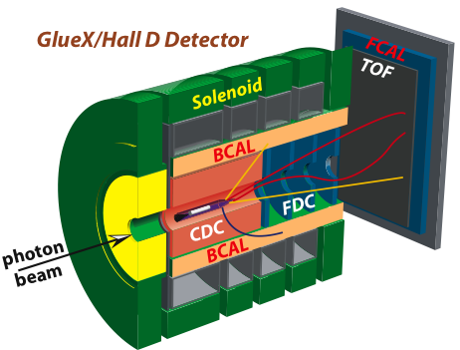
Preliminary Plans for
First Beam in Hall D
Search for Gluonic Excitations (GlueX)
η, η’ couplings, rare decays using Primakoff reaction
12 GeV Commissioning
Primakoff
η→γγ
GlueX
Hardware
10⁷γ/s
Light quark mass ratio
η and η’ mixing angle
Polarized Beam
E_{γ}= 12 GeV
polarized
10⁸γ/s preparations
E_{γ}< 12 GeV
unpolarized
FY 2014
FY 2015
FY 2016
FY 2017

Slide 22
Summary
The project is 68% complete and 79% obligated as of August 31, 2012
We expect to be running beam to Hall A in February 2014 and Hall D later in the year.
The Halls have presented their commissioning and early physics plans to the recent PAC who were impressed with the well-considered mixture of physics impact and practical considerations.

