Slide 1
Observation of Nonstandard Radioxenons
Michael Mayer
ODU Nuclear Seminar Talk
PNNL-SA-188612
Notes:
Stock image of cloud formations

Slide 2
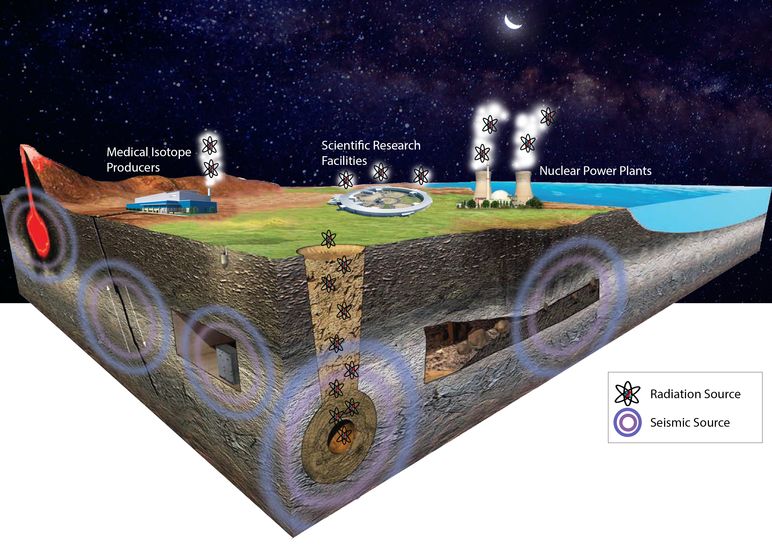
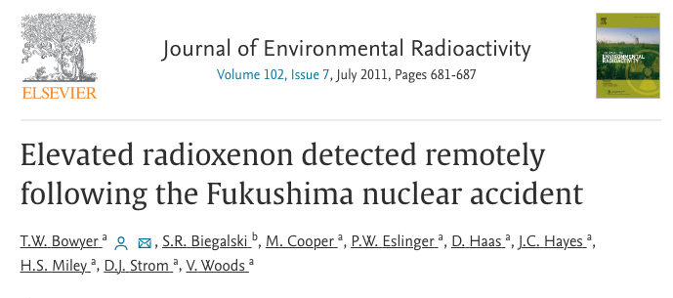
Atmospheric Monitoring for Nuclear Explosions
Radioactive xenon isotopes are monitored around the world for nuclear explosion monitoring
International treaty verification
Background monitoring
Nuclear disaster observations

Slide 3
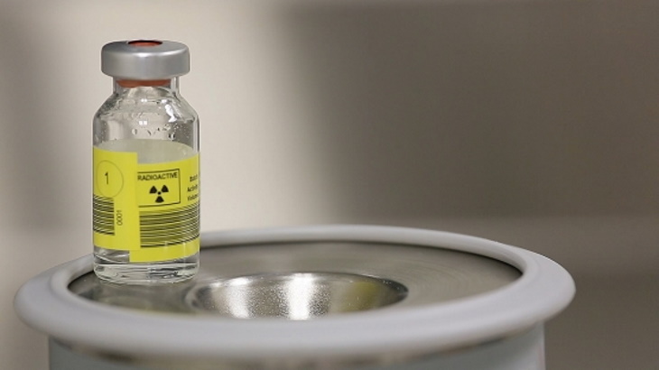
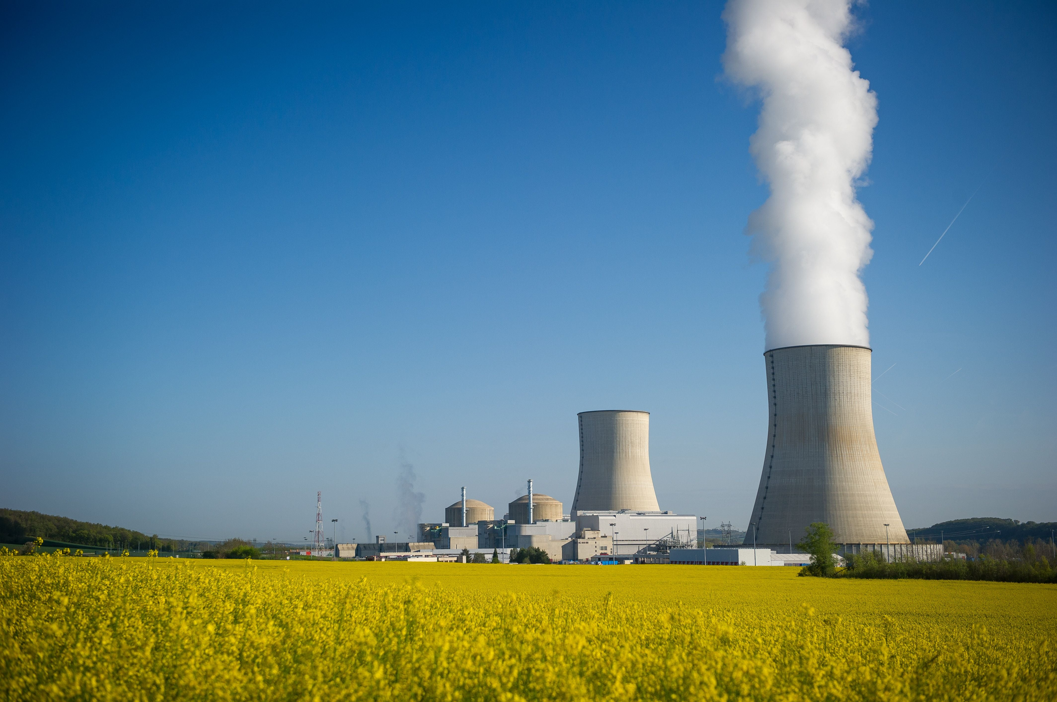
Atmospheric Xenon Sampling
Traditional backgrounds of atmospheric xenon samplers
Medical isotope production facilities
Nuclear reactors
No others observed until now
Conventional radioxenons observed
¹³⁵Xe, ¹³³Xe, ^{131m}Xe, and ^{133m}Xe
Typically observed with electron-photon (beta-gamma) coincidence detectors on an atmospheric radioxenon system

Slide 4
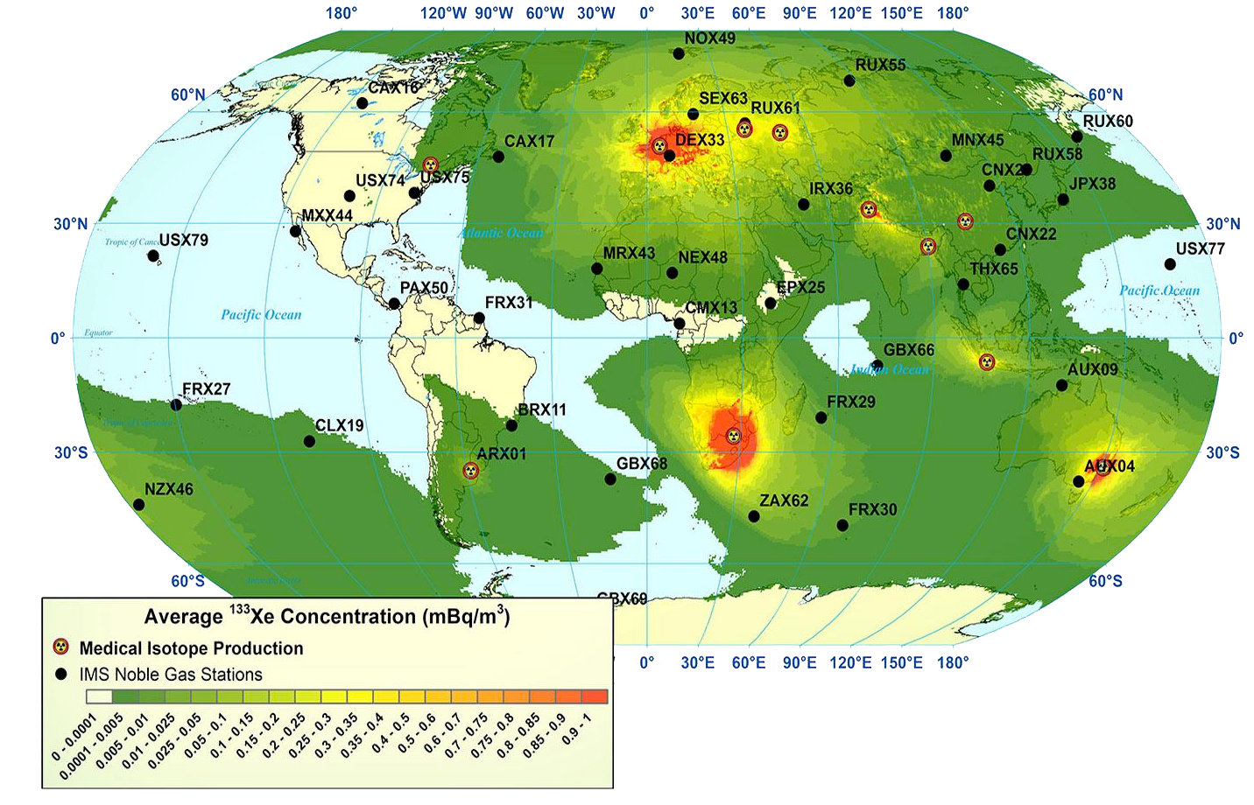
Radioxenon Backgrounds

Slide 5
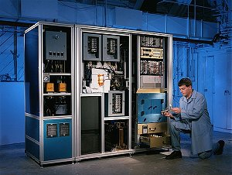
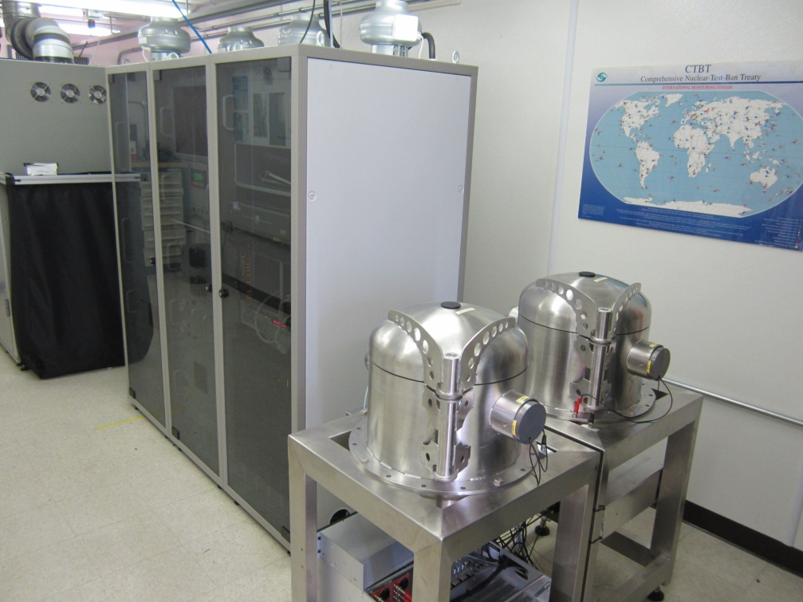
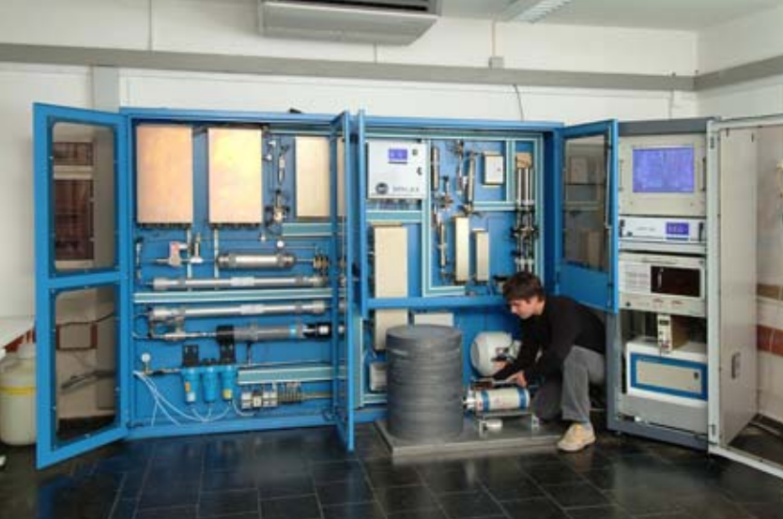
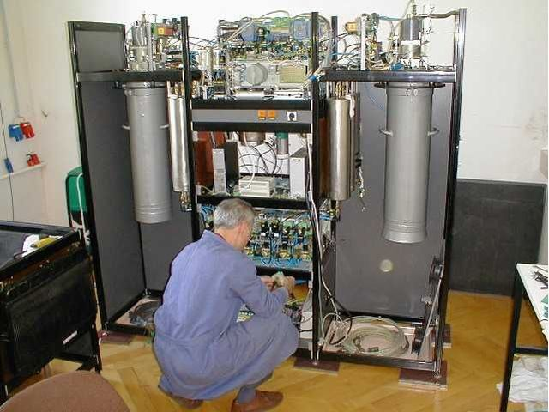
Radioxenon Monitoring Systems
Four technologies for monitoring radioxenon
ARSA - β-γ-coincidence
SAUNA - β-γ-coincidence
SPALAX – High-res γ
ARIX - β-γ-coincidence
One to two samples a day
12-hr to 24-hr collection times
Sensitivities for ¹³³Xe around 0.2-0.6 mBq/m³
Uncoated cells have memory effect
ARSA SAUNA
SPALAX ARIX

Slide 6
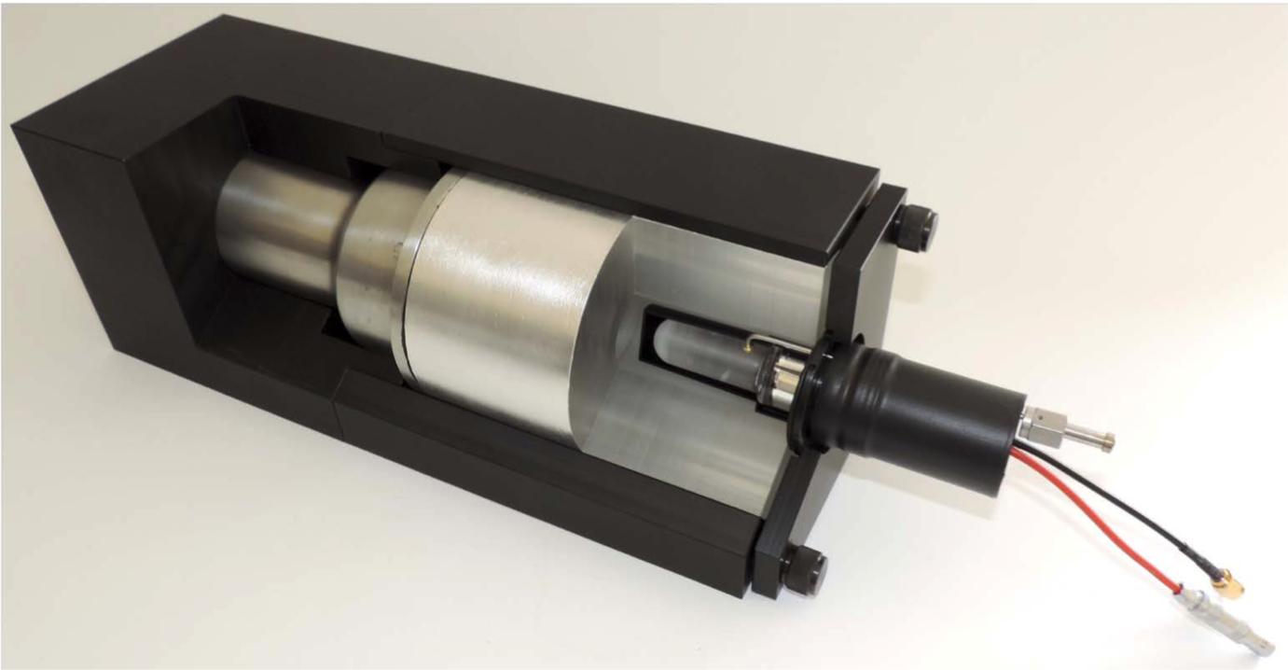
Radioxenon Detection
Xenon coincidence decays
beta and gamma
conversion electron and X-ray
Plastic scintillator to detect the betas and conversion electrons
NaI(Tl) to detect the gammas and X-rays

Slide 7
Beta-Gamma Coincidence Measurements
Typical background suppression
Typical beta-gamma histogram
E_{photon}
^{135g}Xe
^{133g}Xe
E_{beta}
Gamma singles (top)
Beta-gated Gamma (bottom)
^{131m}Xe ^{133m}Xe

Slide 8
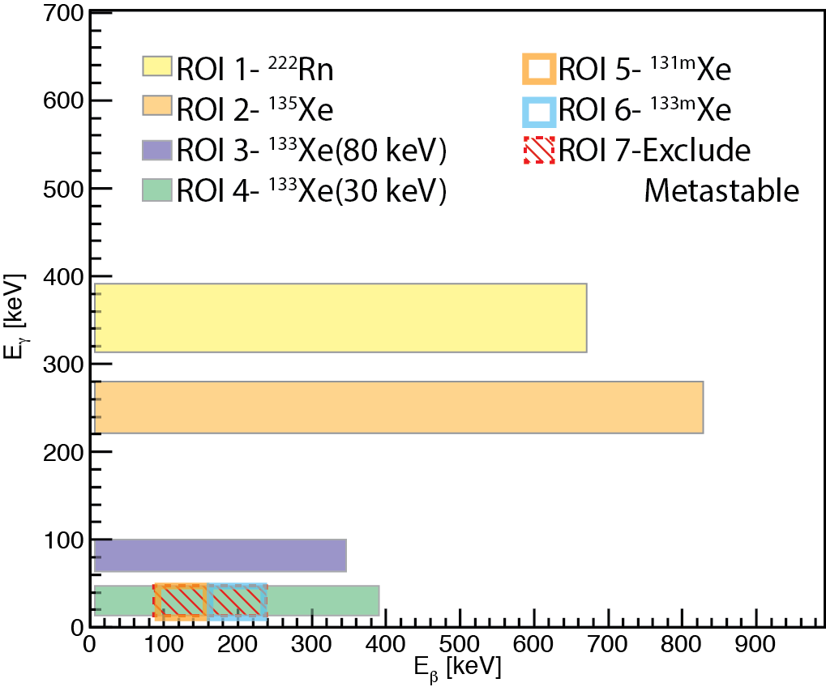
7 Regions of Interest (US Method)
Regions used to determine number of “counts” or decays detected
Regions used to identify largest decay signatures of a specific isotope
Seventh region used to remove Xe-131m and Xe-133m from Xe-133
The 30-keV region of ¹³³Xe contains ^{131m}Xe and ^{133m}Xe

Slide 9
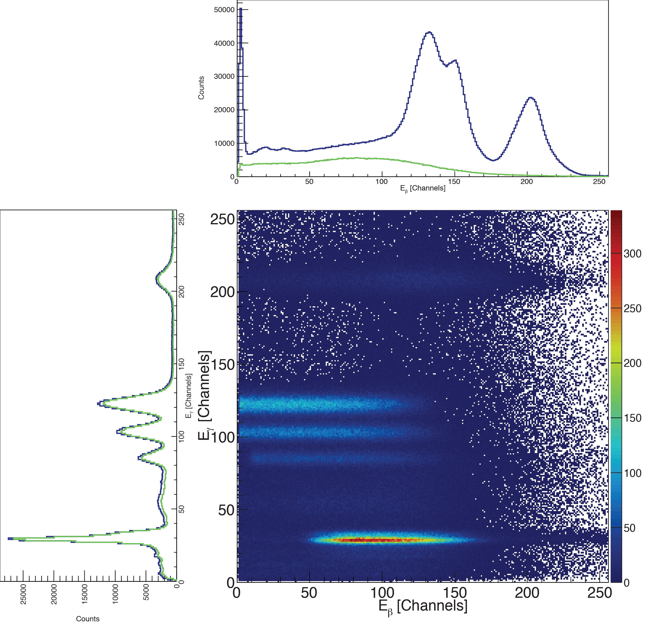
Example Spectra
Background ²²²Rn (²¹⁴Bi and ²¹⁴Pb)

Slide 10
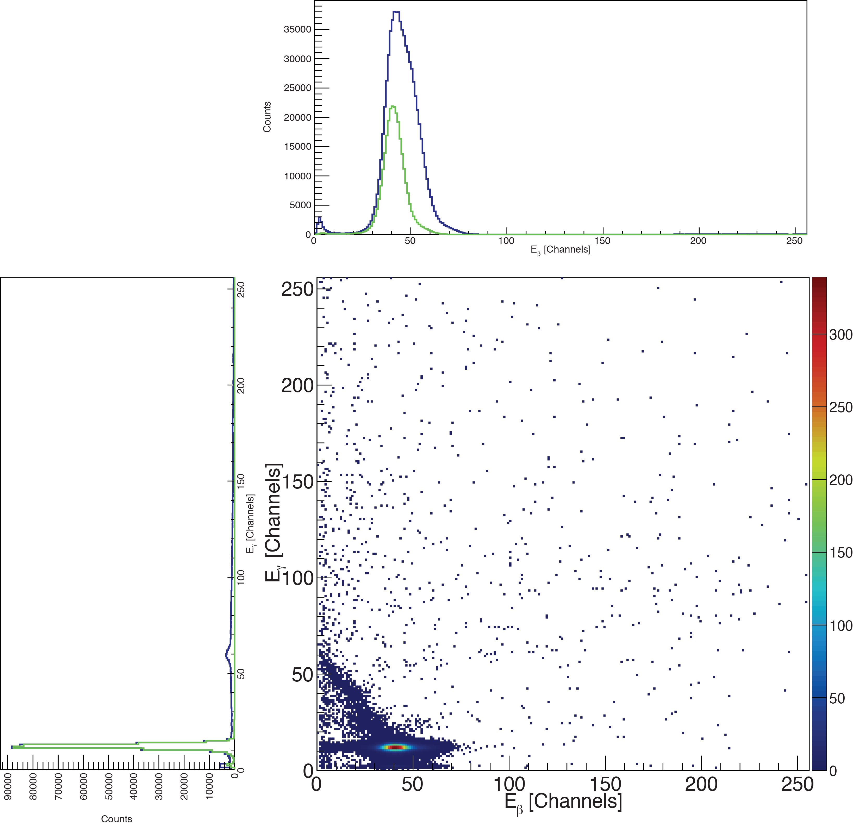
Example Spectra
¹³⁵Xe ^{131m}Xe

Slide 11
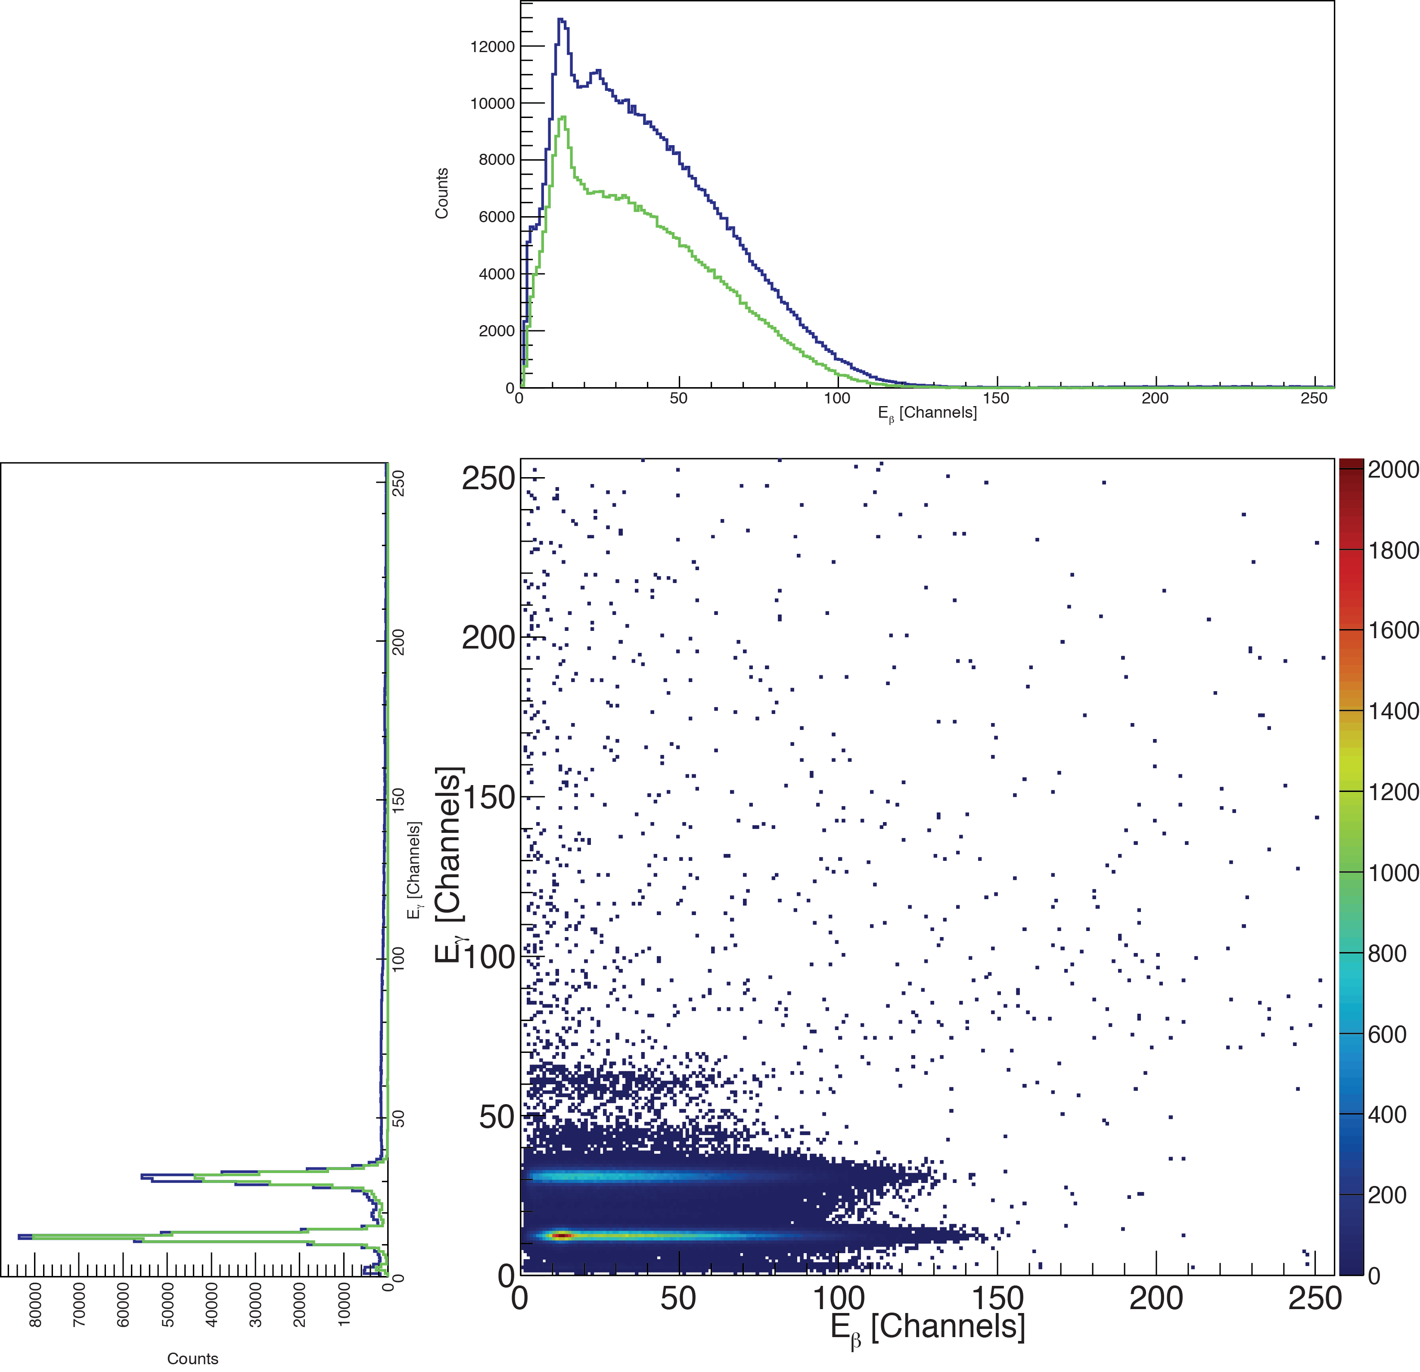
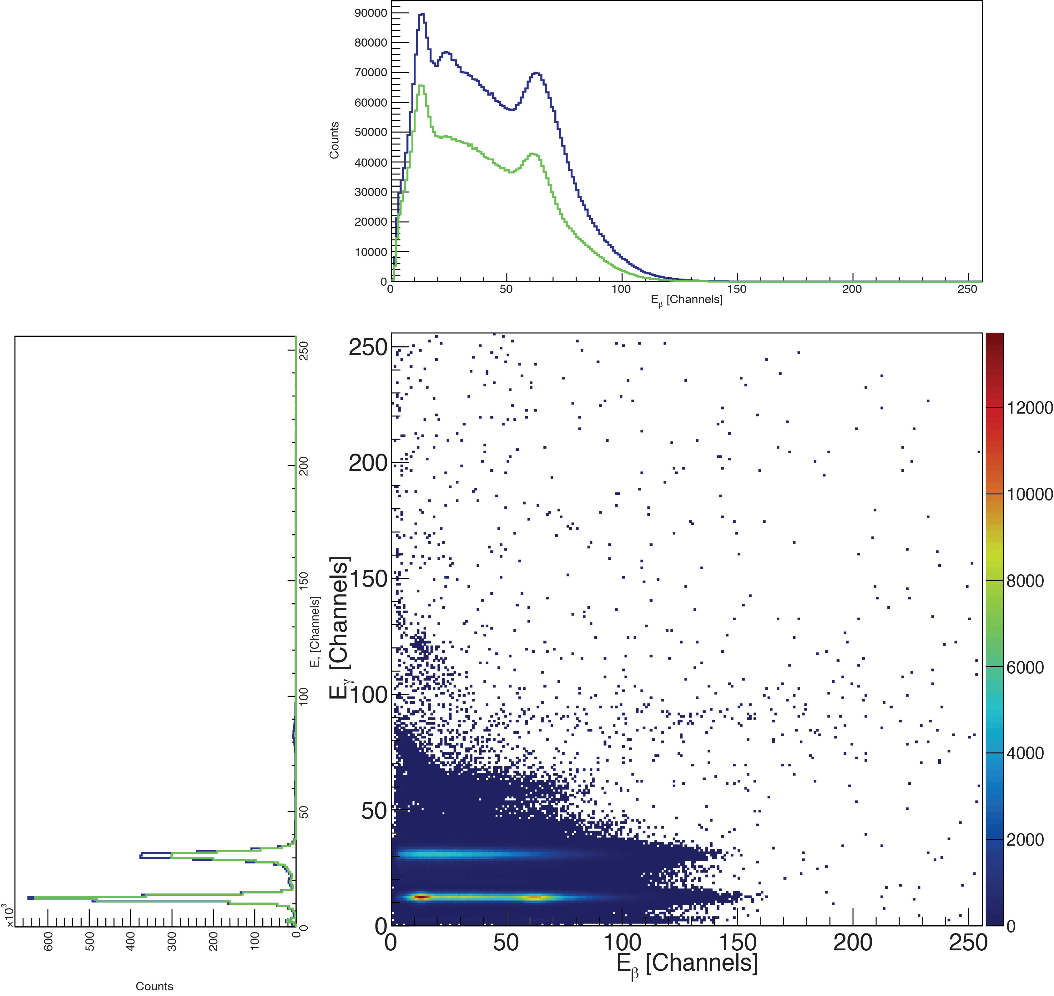
Example Spectra
¹³³Xe ^{133m}Xe (¹³³Xe)

Slide 12
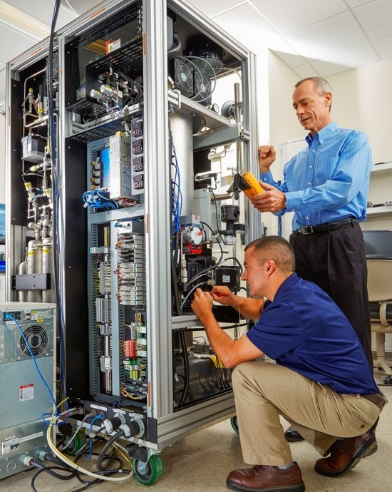
Xenon International
Next generation atmospheric radioxenon system
Developed at PNNL
Transitioned to Teledyne Brown Engineering for production (Knoxville, TN)
Faster and more sensitive than current certified systems
~2.5 cc of xenon in 6 hours
Compared to ~1 cc for SAUNA
Minimum Detectable Concentrations
<0.15 mBq/SCM for ¹³³Xe, ^{131m}Xe, ^{133m}Xe
<0.5 mBq/SCM for ¹³⁵Xe

Slide 13
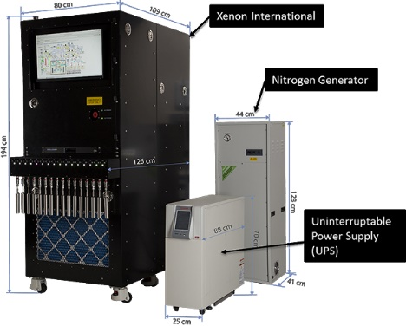
Xenon International
Next generation atmospheric radioxenon system
Developed at PNNL
Transitioned to Teledyne Brown Engineering for production (Knoxville, TN)
Faster and more sensitive than current certified systems
~2.5 cc of xenon in 6 hours
Compared to ~1 cc for SAUNA
Minimum Detectable Concentrations
<0.15 mBq/SCM for ¹³³Xe, ^{131m}Xe, ^{133m}Xe
<0.5 mBq/SCM for ¹³⁵Xe

Slide 14
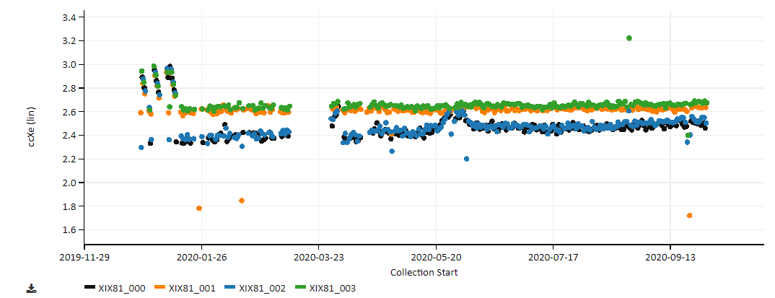
Testing at TBE in Knoxville, TN
Four detectors running consecutively
Average ~2.5 cc per run
Nothing anomalous noticed
Run sample measurements were good
System during the time frame was good

Slide 15
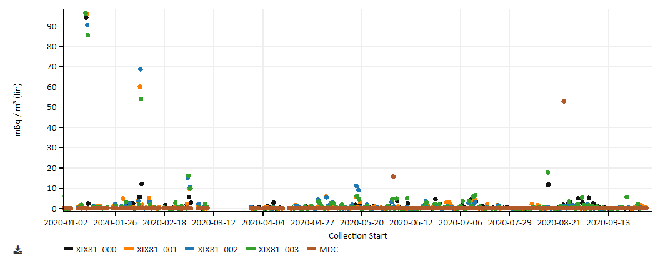
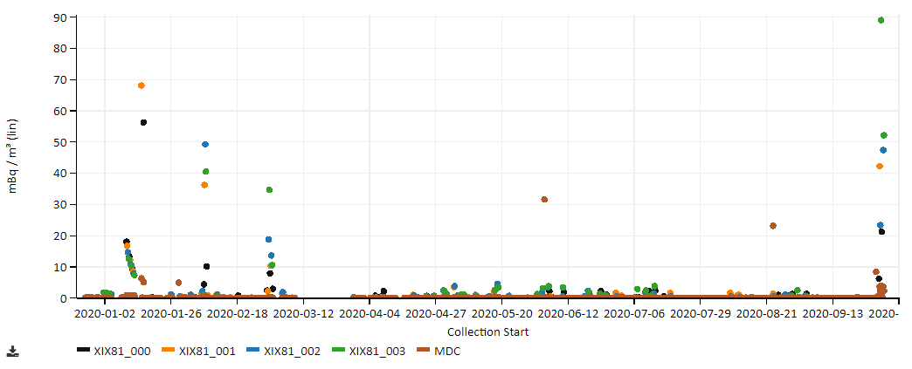
Puzzling Observations and Analyses
¹³³Xe
At initial glance, everything seems to be going well
¹³³Xe – no unusual levels observed for the area
¹³⁵Xe – high but also not too unusual for the area
^{133m}Xe – unusual to have higher than concentration than ¹³³Xe
^{131m}Xe similar to ^{133m}Xe
Further investigation showed that the gamma-ray spectrum has unusual features.
^{133m}Xe

Slide 16
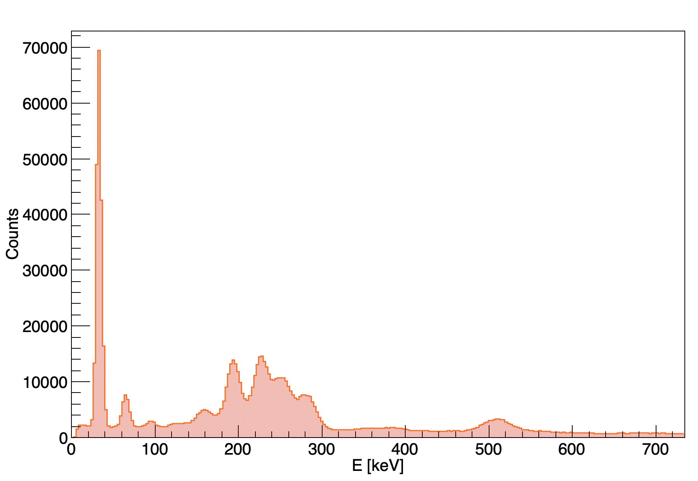
Puzzling Observations and Analyses
At initial glance, everything seems to be going well.
¹³³Xe – no unusual levels observed for the area
¹³⁵Xe – high but also not too unusual for the area
^{133m}Xe – unusual to have higher than concentration than ¹³³Xe
^{131m}Xe similar to ^{133m}Xe
Further investigation showed that the gamma-ray spectrum has unusual features.
Does not look like traditional Xe or Rn daughters
Gamma Singles Spectrum

Slide 17
Atypical Coincidence Signatures

Slide 18
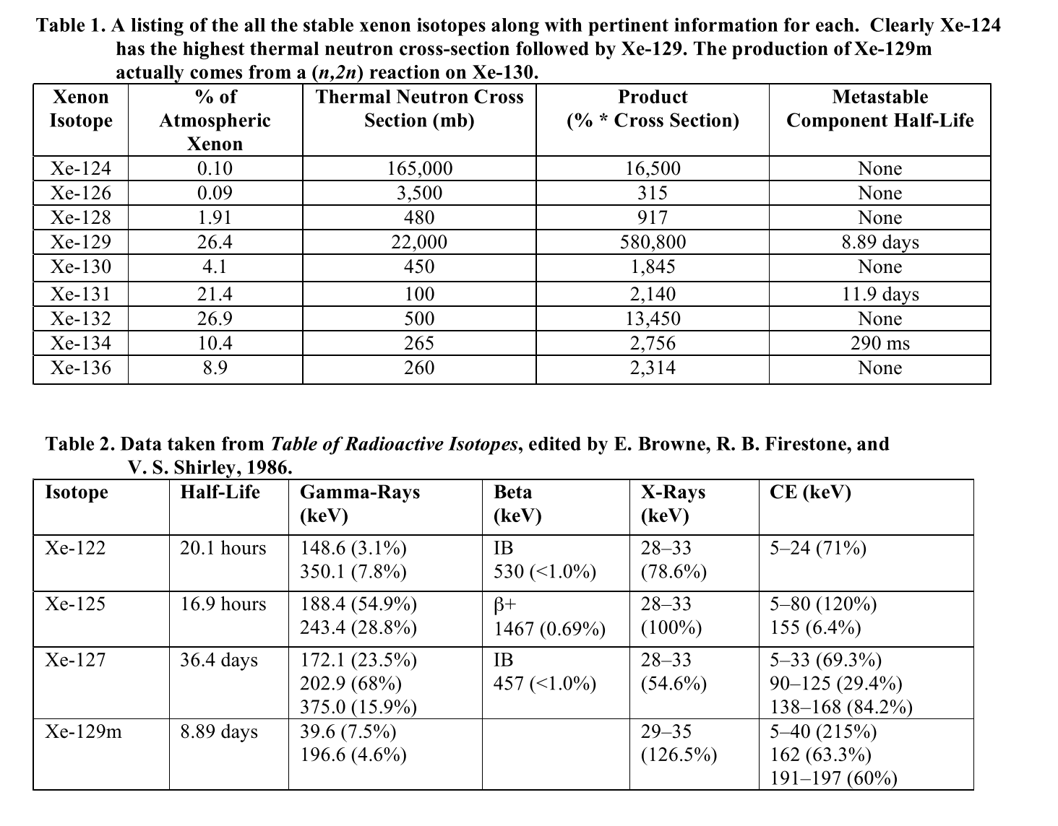
Isotope Identification
Assuming system working optimally
Only Xe in system
Possible Xe isotopes observed experimentally previously
¹²⁷Xe and ¹²⁵Xe
Produced via neutron irradiation
¹²⁵Xe, ¹²⁷Xe, and ^{129m}Xe all identified in data sets
¹²²Xe originally disregarded as candidate due to only being produced as medical isotope via proton or alpha bombardment
McIntyre, Justin I et al.. 2008. “Generation of Radioxenon Isotopes.” In Proceedings of the 30th Seismic Research Review: Ground Based Nuclear Explosion Monitoring Technologies, 793–801.

Slide 19
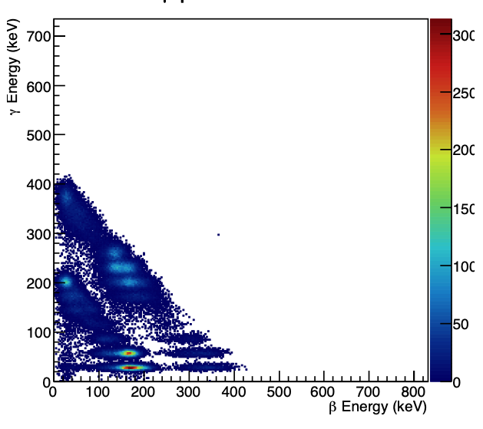
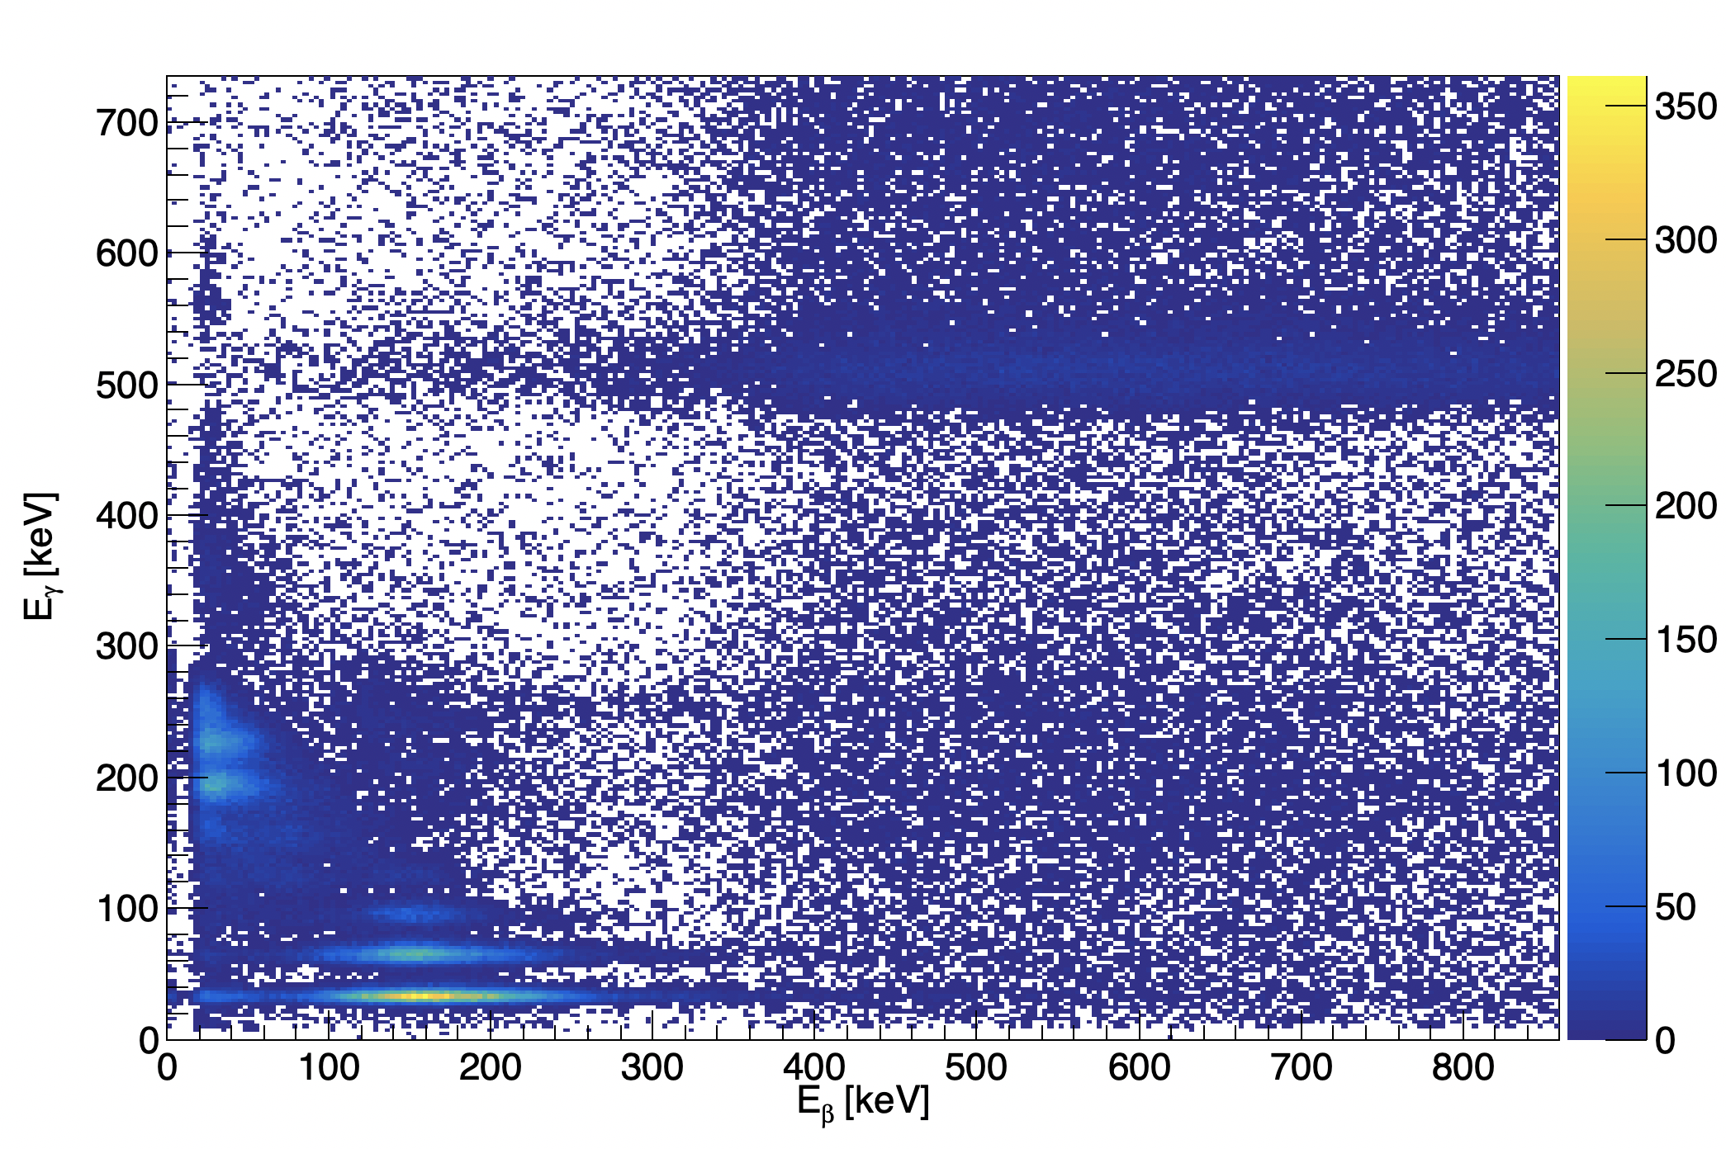
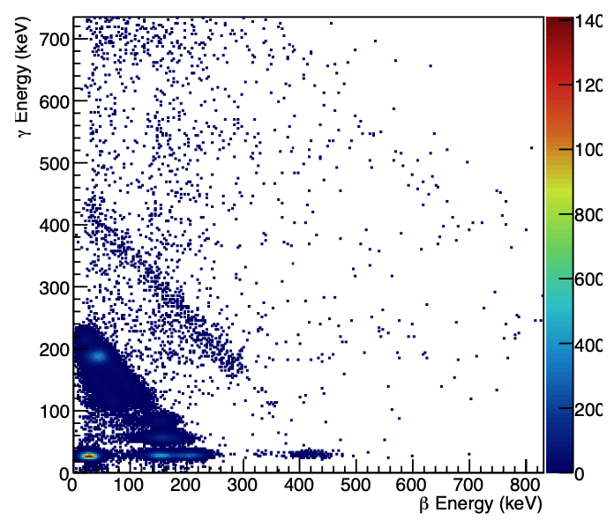
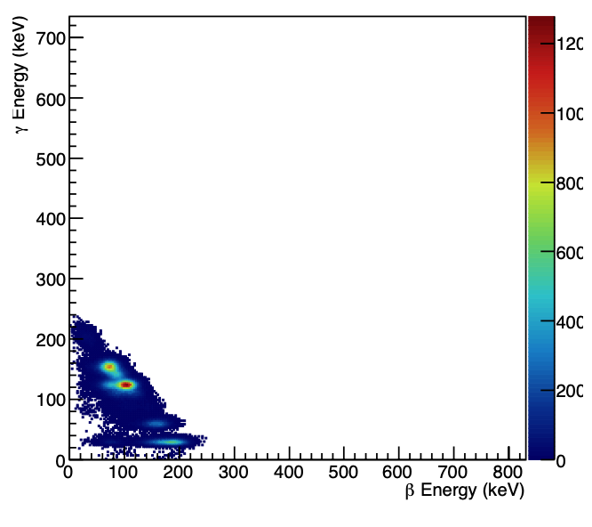
Monte Carlo Simulations
¹²⁷Xe Simulation
Monte Carlo simulations performed to observe clean signatures and extract efficiencies
Region at 511 keV in gamma energy not identified with simulations
Xenon International Measurement
^{129m}Xe Simulation
¹²⁵Xe Simulation

Slide 20
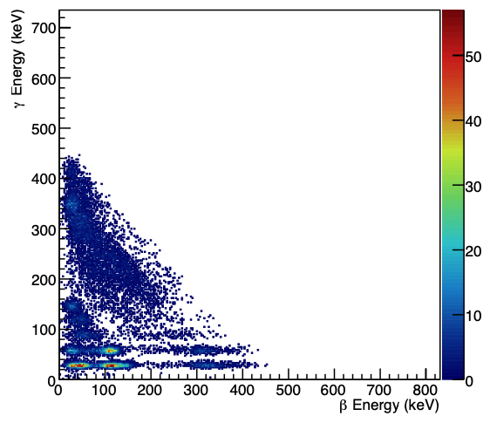
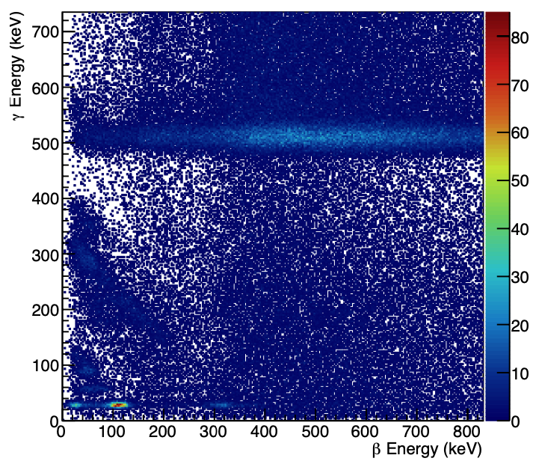
Missing Piece
¹²²Xe did not originally seem to produce missing signature
Including daughter ¹²²I (T_{1/2}=3.63 minutes) produces missing signature
Production does occur via spallation in the mercury target at SNS
¹²²Xe Only Simulation
¹²²Xe Full Decay Chain Simulation

Slide 21
How much did we see? Xe-122 Concentration Analysis
The concentration can be calculated using the Bateman equations
Relates number of counts of ¹²²I to starting amount of ¹²²Xe
Assumed no memory effect (coated cells)
Decay corrected to account for collection and processing time
Acquisition decay accounted for with Bateman equation
MDC can be formulated using the standard equations
Efficiency values obtained from simulation
$${Conc}_{{}_{ }^{122}{Xe}}(\frac{mBq}{m3})=\frac{{ΔC}_{{}_{ }^{122}I}}{\frac{λ_{{}_{ }^{122}I}}{λ_{{}_{ }^{122}I}−λ_{{}_{ }^{122}{Xe}}}\left[\left(\frac{1}{λ_{{}_{ }^{122}I}}e^{−λ_{{}_{ }^{122}I}T_{A}}−\frac{1}{λ_{{}_{ }^{122}{Xe}}}e^{−λ_{{}_{ }^{122}{Xe}}T_{A}}\right)+\left(\frac{1}{λ_{{}_{ }^{122}{Xe}}}−\frac{1}{λ_{{}_{ }^{122}I}}\right)\right]}∗\frac{1}{ε_{γ}ε_{β}{BR}_{γ}{BR}_{β+}}$$
*$\left(\frac{λ_{{}_{ }^{122}{Xe}}T_{C}}{1−e^{−λ_{{}_{ }^{122}{Xe}}T_{C}}}\right)\left(\frac{1}{e^{−λ_{{}_{ }^{122}{Xe}}T_{P}}}\right)$ $\left(\frac{1000}{V_{Air}}\right)$

Slide 22
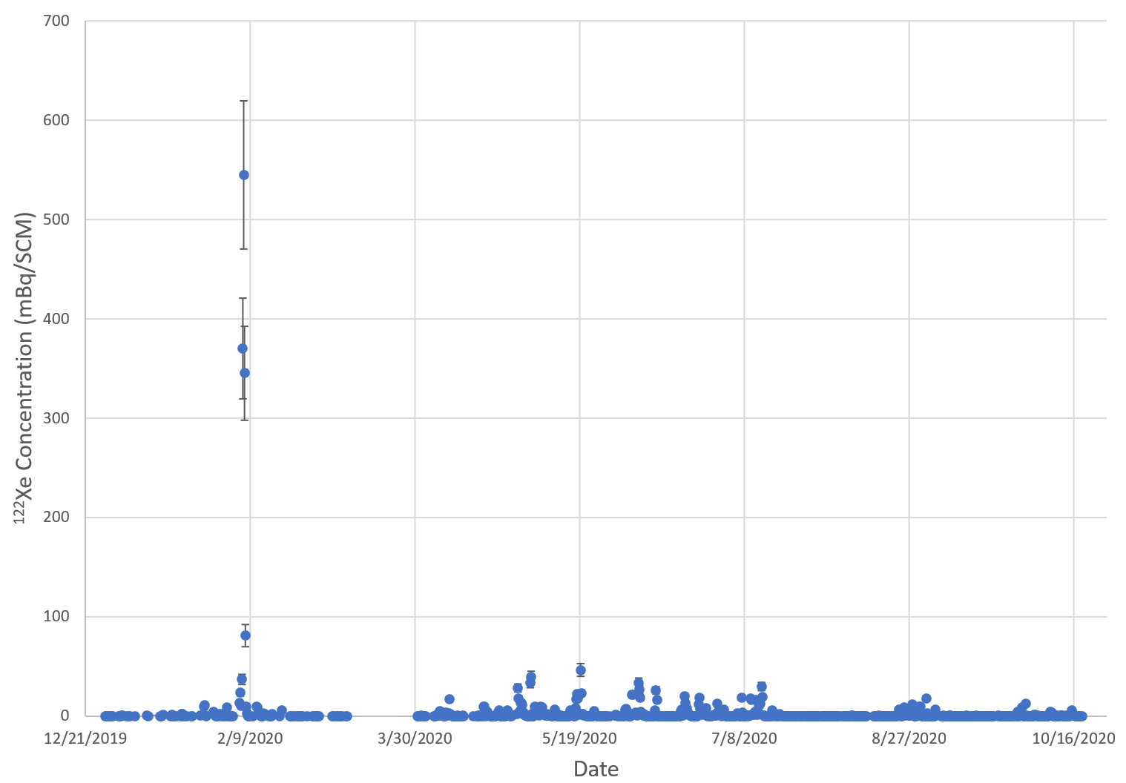
Concentration of ¹²²Xe over Sampling Period

Slide 23
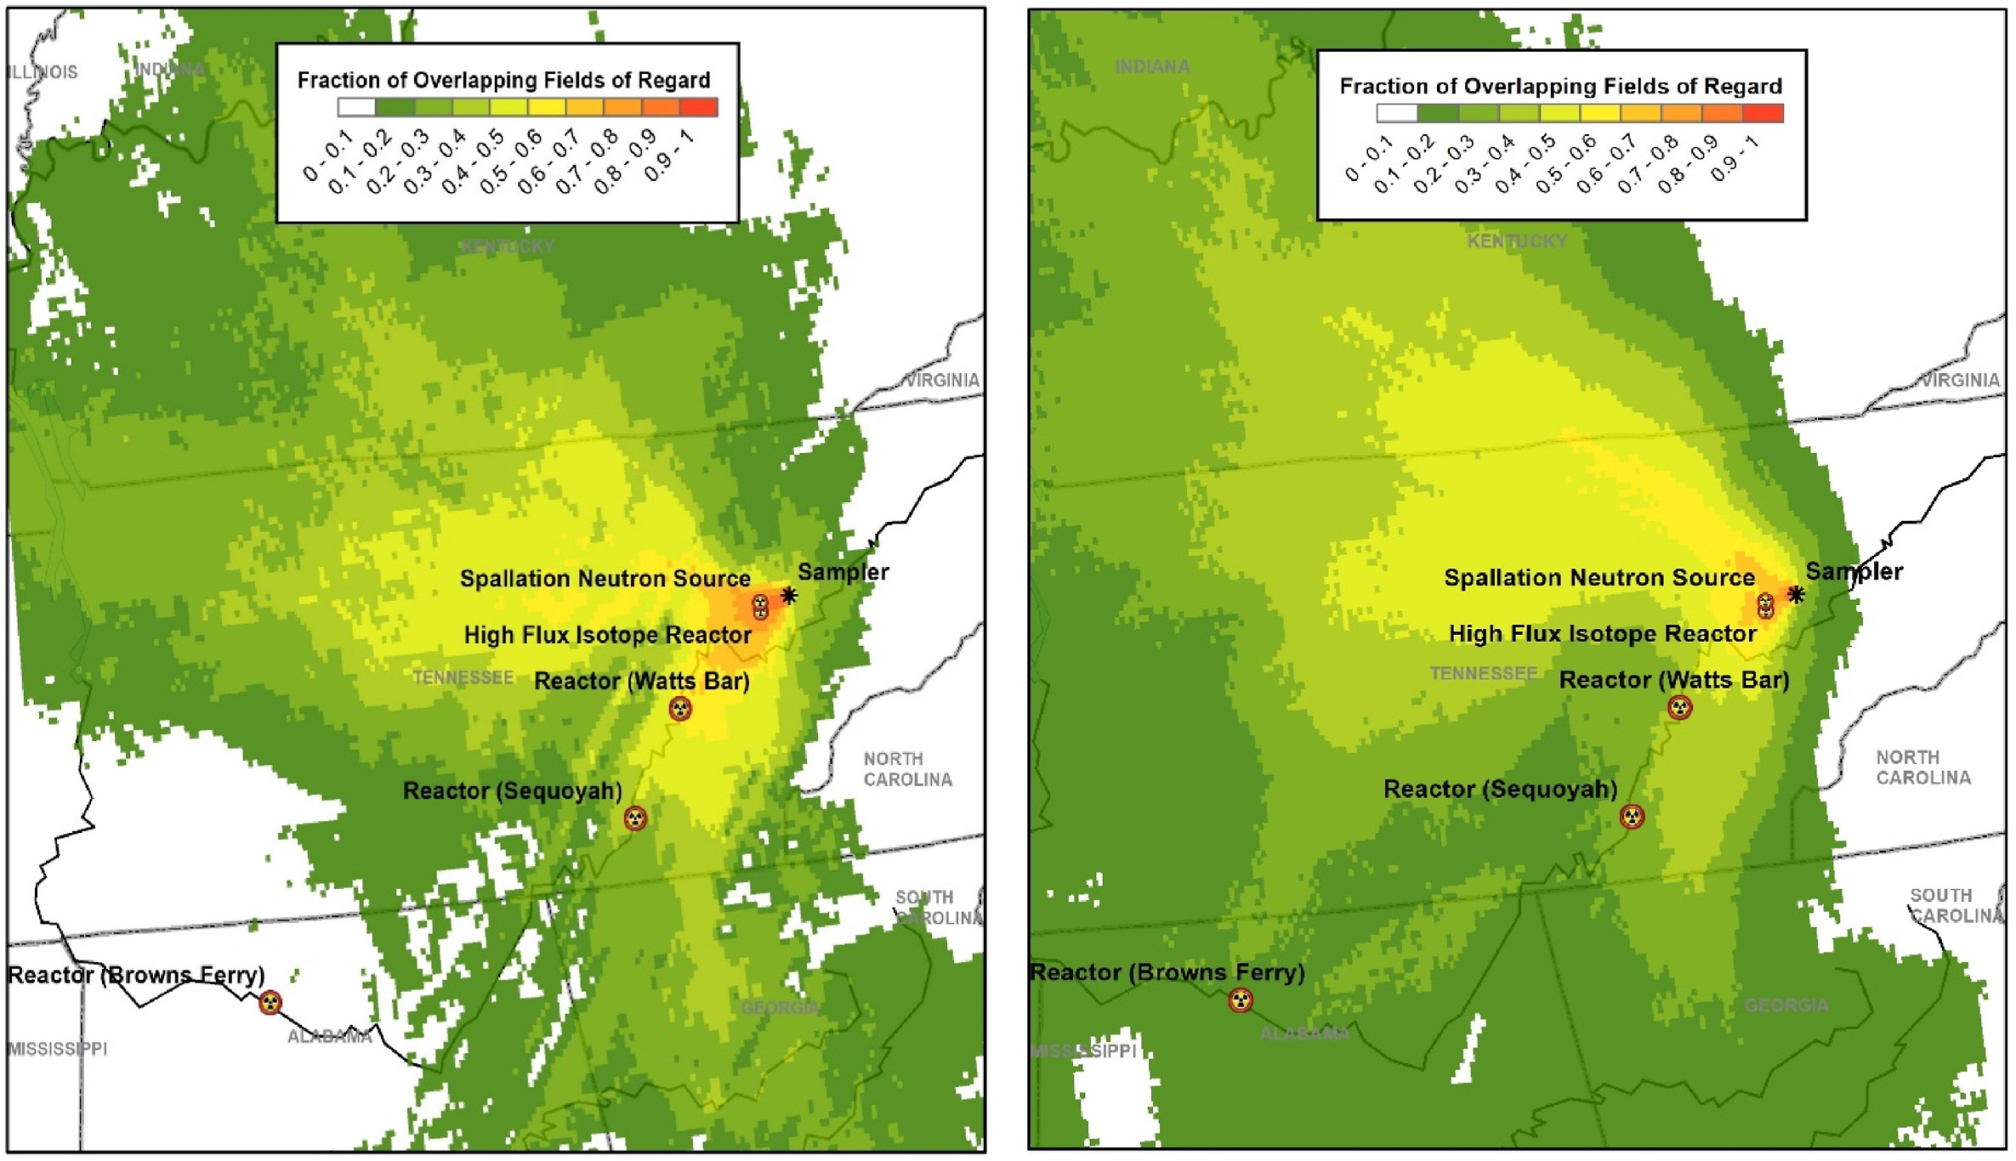
Atmospheric Transport Modeling
Modeling suggests that likely release is from HFIR or SNS
Wind patterns are not consistent with release from the nuclear power plants
Production mechanism suggests
SNS only
SNS and HFIR
Publication on ATM
Eslinger, Paul W. et al. 2022. “Determining the Source of Unusual Xenon Isotopes in Samples.” Journal of Environmental Radioactivity 247 (June): 106853. https://doi.org/10.1016/J.JENVRAD.2022.106853.

Slide 24
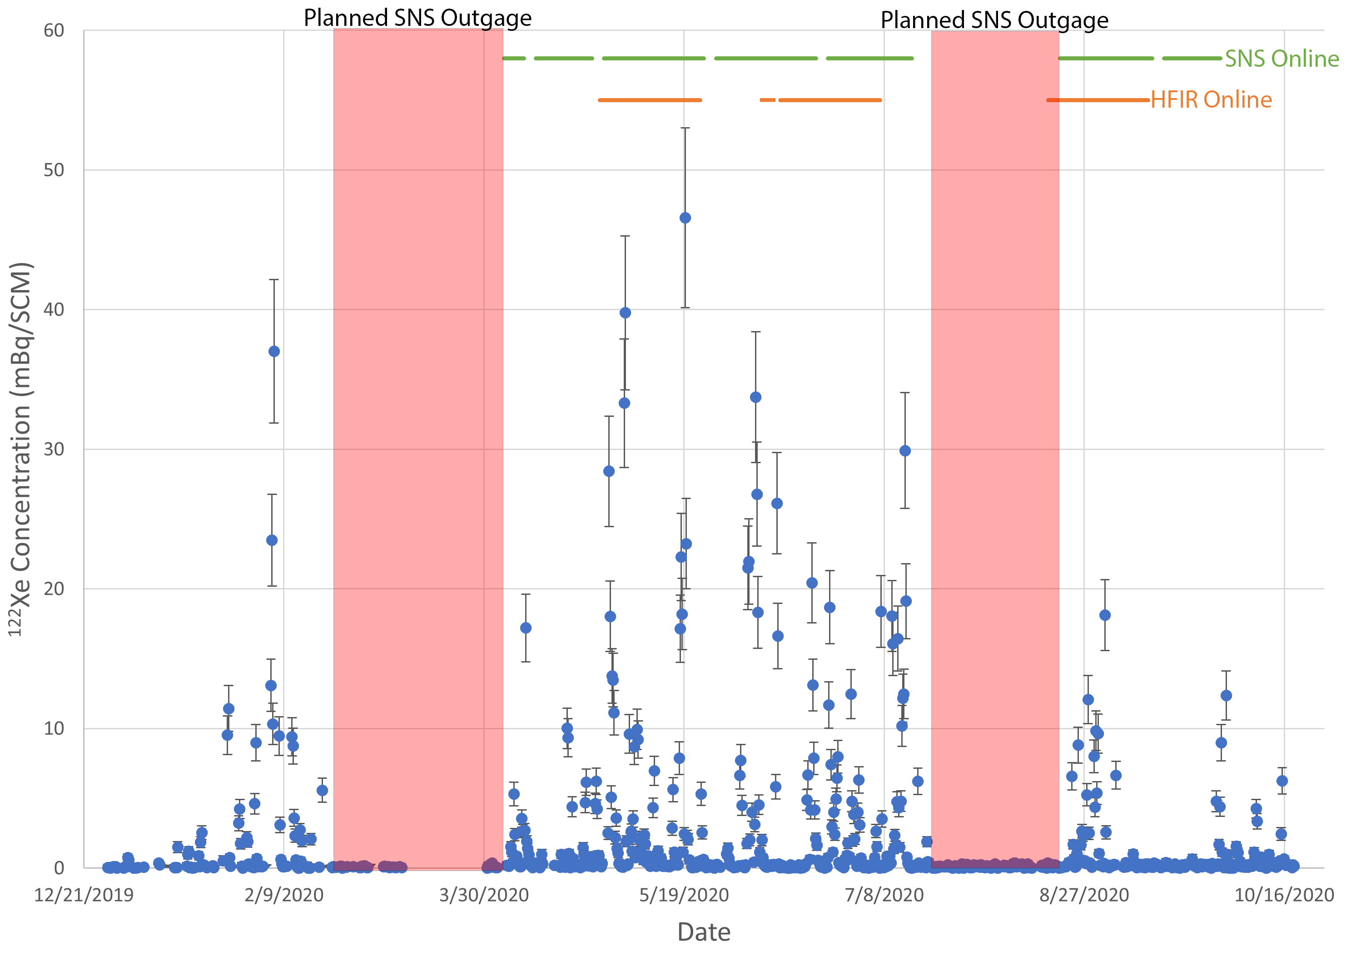
¹²²Xe Concentration: Schedule Overlayed/Zoomed
*No operational dates prior to the first SNS outage

Slide 25
Conclusion and Outlook
Newly observed isotopes seen near HFIR and SNS suggest new source of interfering xenon background (scientific research facilities)
Neutron irradiation and spallation facilities can produce and release xenon
Several online or coming online:
ISIS neutron source in the UK,
Japan Proton Accelerator Research Complex (J-PARC) in Japan,
Los Alamos Neutron Science Center (LANSCE) and SNS in the USA,
European Spallation Source in Sweden, and the
China Spallation Neutron Source
New isotopes interfere with all traditional ROIs used for activity calculations
Algorithms will continue to calculate normally
Concentrations and ratios will not make sense
Preliminary work completed identifying source(s) and quantifying
Concentration values have been calculated for ¹²²Xe
Work needs to be done to determine observation elsewhere and impact

